Slide 1

MAD-6123 Mobile Server Development
NODE.JS
Express.js web server
NO-SQL Database
RESTful APIs: web services
Lambton College 2020 Summer
Instructor: Peter Sigurdson

Slide 2
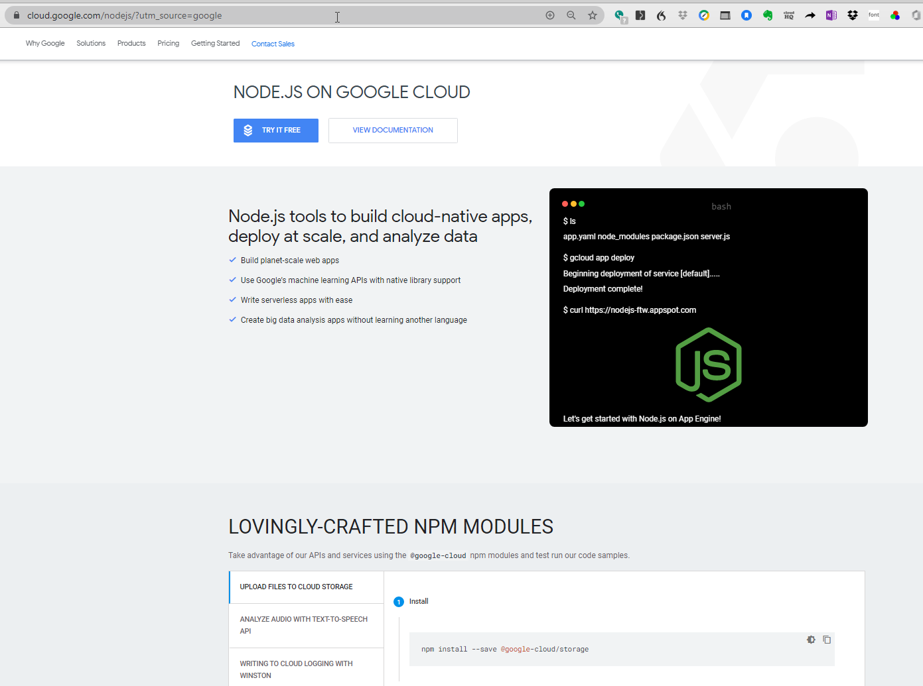

Slide 3
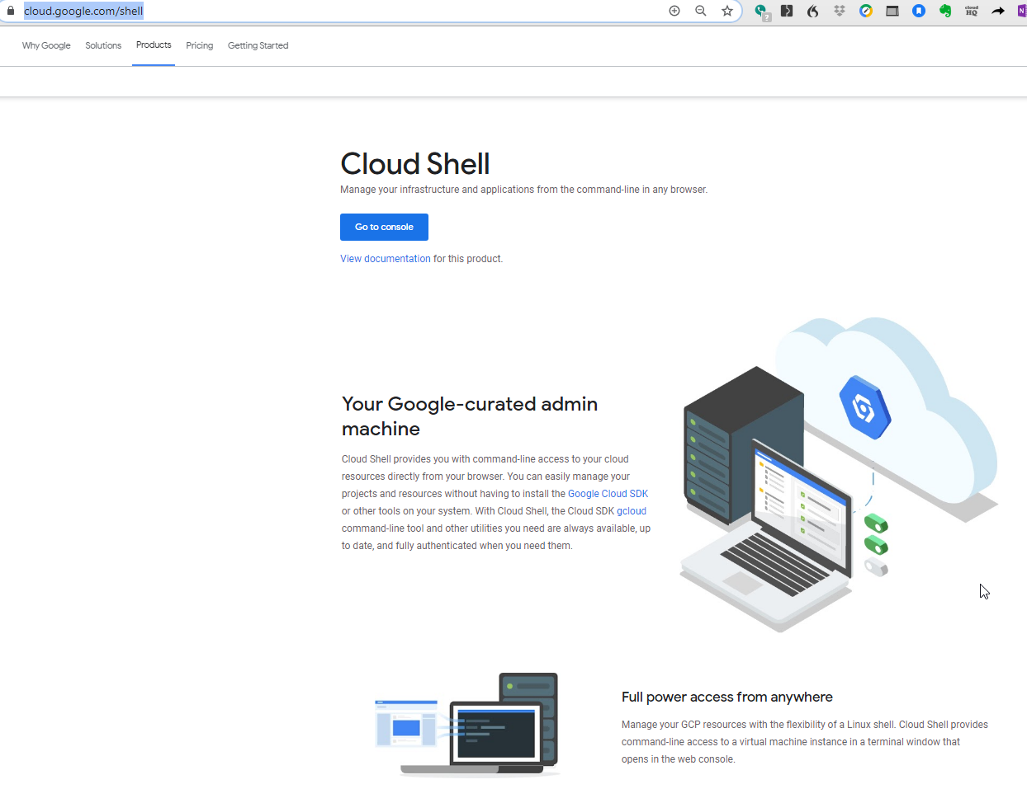

Slide 4
Lab Test 1: Thursday July 30
Test will be in the last hour of class
You will receive a Word Document with instructions.
You rename that document to your name-studentID.docx
When complete: upload to a provided Dropbox Link.
Instructions:
Following In Class Lab Exercises:
Using SQLiteDBrowser, create a SQLite Database
Write some code with Node.js Express.js to pull information out of the database and display it on a webpage.
You might use MONGO DB as your Database.
Your hand in work will be screenshots of your Work -> copy/pasted into your Word Document.

Slide 5
Computational Thinking
Computation Thinking mean you can a business process or situation and figure out, use your comprehension and imagination, to see:
1. What the pieces of the solution ARE
2. How to fit them together.
Our job as Informatics Specialists is to put the right pieces of the solution into the right parts of the architecture.

Slide 6
Where does each piece of my Program Code go?
The Database | Customer or other business data goes here | You can also put business RULES (processes) here. This is a more advanced topic!
The View | Show information to user and collect input back from user . | The GLASS is the user’s experience of the system. Unified Process: Calls this UI Prototyping.
The CONTROLLER | This is the code which I write. This is where I make the application come to life. I get the stuff to happen. I implement the ALGORITHMS and the BUSINESS PROCESSES. | We also talk about MIDDLEWARE. So examples might be cryptography. Or Message Queuing.

Slide 7
Review on MODULES in Node.js
Node.js file
Colors.js
Function pickColor()
Export this function:
Name the function
a = pickColor();
export a;
Node.js file
ColorPickerApp.js
I am import pickColor()
From another file:
var a = require(‘a’)

Slide 8
The difference between Client Server (2 tier) and the 3 tier architecture is that in the 3 Tier architecture, we factor out the Database Server to be in its own separate section of the Application.
Basis of the Model View Controller Design Pattern:
Model View Controller Design Pattern is the basis of all modern web applications:
Presentation Layer (View) take cares of the user interact via HTML, or REACT for mobile.
Business logic layer (Controller) is the partition, or tier of the system where we write our ALGORITHMS to implement the use cases
The Data store layer (model) is where store the business data.

Slide 9
This is an introduction to
Software Architecture
How to put together the pieces of a software application
To make product that people will benefit from using
Node.js is the language we are using
Model View Control and 3 Partition Architecture are the WAYS that we organize the pieces and the algorithms to deliver the product
This is what you are doing in your project!

Slide 10



Behold the 2 Tier Application: CLIENT SERVER
Let’s start by telling our story at the level of the Client Server
What does Client Server mean?
In 1975: very few home computer, very low power
Big companies STARTING to use computers
1000s of dumb terminals / users connecting to one server
SERVER was in a locked away room
Users had access ONLY to a terminal: this terminal let users access the server remotely
Earliest computer networks were developed in the 1960s
server
Client partition or tier

Slide 11

The concept of the Partition
A partition in a software system is a set of files (maybe by directory, maybe by schema) which are focused on doing a specific job.

Slide 12
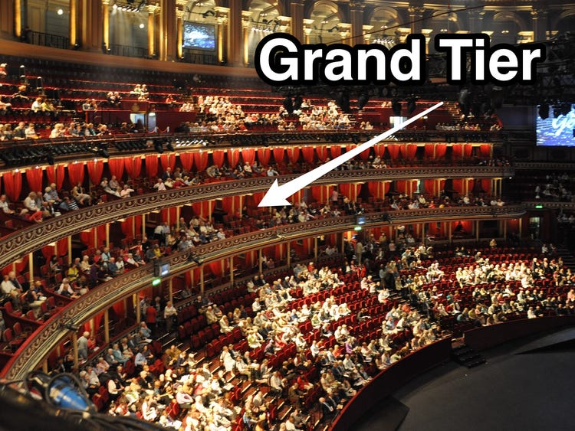
Partitions can also be called TIERS

Slide 13
How do partitions or TIERS apply to software systems (software architectures):
What things do we need to take care of when we create a software application?
What kinds of stuff does a Software Application program need to do?

Slide 14
Our Goal is to make you a top 10% programmer

Slide 15

Any material from the Lab Worksheets could be the basis of Final Test questions

Slide 16
Course Topics Table
Developing Applications with TypeScript and Node.js
Understanding the Node.js Event Loop Node’s Event-driven Architecture: Lab Worksheet
Building the Web Application with the MVC Design Pattern: Lab Worksheet
The Role of the Database – Building the Database with SQLite: Lab Worksheet
The Web Server: express.js
MONGO DB and the NOSQL Database Concept

Slide 17
CAREER PROGRESSION PATH FOR THE IT PROFESSIONAL
START AS JUNIOR PROGRAMMER / ANALYST: IN THIS ROLE THE PROGRAM TEAM LEADER GIVES YOU A LITTLE PROBLEM TO SOLVE AND YOU WRITE CODE TO SOLVE IT
AFTER A YEAR: YOU WILL PROMOTED TO SENIOR PROGRAMMER ANALYST
IN A COUPLE OF YEARS (ONCE YOU KNOW THE PRODUCT AND THE CODE AND THE PROBLEMS OF THE CUSTOMER OR BUSINESS DOMAIN): YOU WILL BE PROMOTED TO TEAM LEADER
NEXT STEP IS TO BE AN INFORMATION ARCHITECT: CODE + INFRASTRUCTURE (= PRODUCT +THE BUSINESS DOMAIN)
SENIOR MANAGER // PROGRAM PROJECT MANAGER
PROMOTED TO THE LEADERSHIP LEVEL, CHIEF INFORMATION OFFICIER
ITEMS 4 AND 5 ARE THE PROFESSIONALS WHO WOULD BE IN CHARGE OF DESIGNING THE BUSINESS RULES WHICH THE PRODUCT DELIVERS.

Slide 18
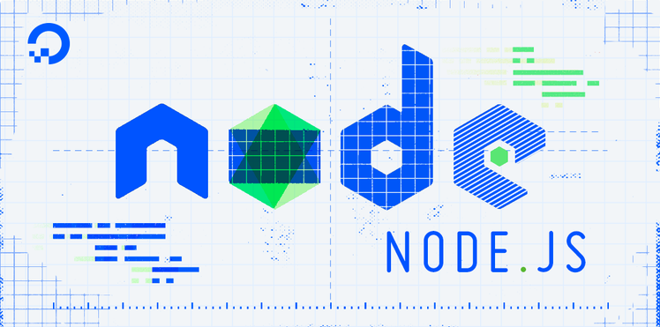

Slide 19
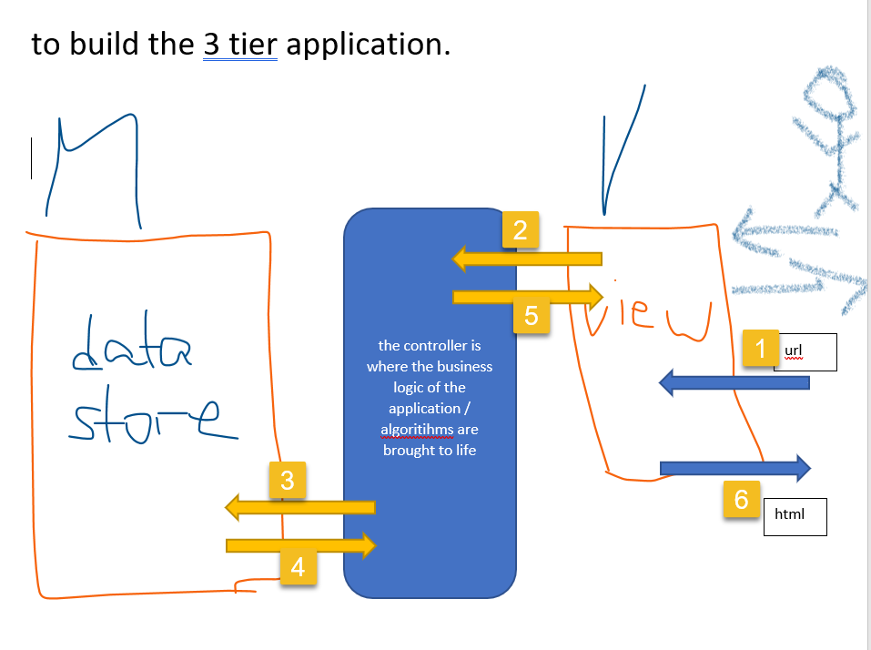

Slide 20
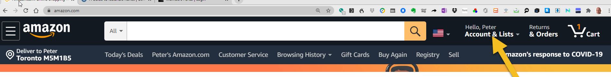
The components of the Web Application
The big limitation of web applications is that we limited to the request-response cycle. This has no memory.
Ways to “add a memory of events” to the request-response HTTP cycle include:
Cookies are small text files stored on a small “sandboxed” part of the file system that the browser is allowed to access
That is a Web Site can remember who you are:

Slide 21
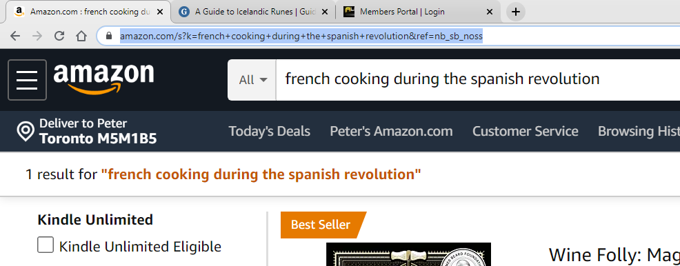
In addition to cookies, we can use URL Rewriting to create a “memory of events” between request response cycles:

Slide 22
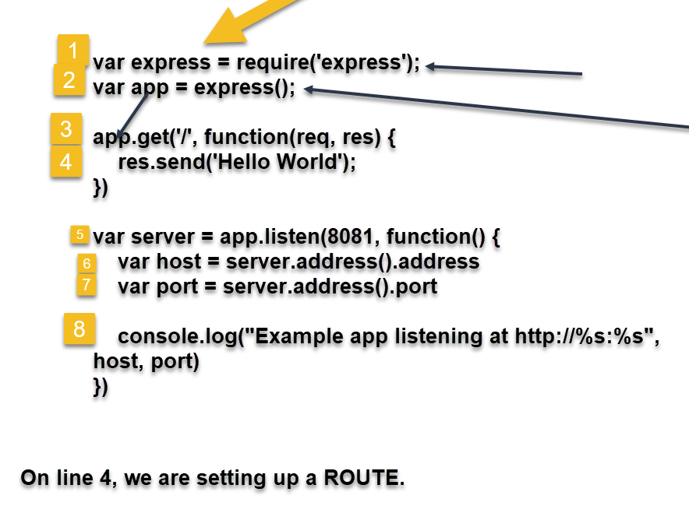
A simple example of an Express.js Node Web Server highlighting simple routing:

Slide 23
What is the INTERNET:
GO and take some Lynda.com course basic TCP/IP Networking
What is the Internet:
It is a SET of Internet-Protocol connecting computers which are Packet Forwarding Router. This forwarding happens due to the operation of the Domain Name Server System.

Slide 24
Concept of ROUTING in a NODE.js Web Application.
Server
Express.js application:
Our application has number of methods, methods have names
Internet
BROWSER
ADDRESS BAR
FACEBOOK.COM/HELP
ROUTING VERB
Routing means that the routing verb IS the name of the method that we want to invoke and send us back a response

Slide 25
Using JSON to move data around
JSON: JavaScript Object Notation
It is file format; just HTML is a file format
HTML is a PAGE DESCRIPTION LANGUAGE
JSON is a Data Description Language
JSON is a way of TAGGING data so we can use parsers to process it.
JSON is based on XML : extensible mark up langage
HTML is also an extension of XML for a very specific problem domain: in this case: positioning visual elements on the Web Document Canvas

Slide 26
The 2 Reasons for using JSON:
“FREEZE DRYING OF DATA TO SHIP IT AROUND: We can move OBJECTS around from between partitions of the system by “freeze drying them” meaning we convert the binary object in program memory into a file format. We can ship that file over the Internet to somewhere else. When it is received, the receiver can re-assemble the JSON Data Representation into an OBJECT in the Program Space of the REMOTE system.
JSON gives us a SCHEMA to describe our data. We can use that SCHEMA in our program algorithms to manipulate that data in a better way. Use can use language-specific parsers to process the data.

Slide 27
A simple example of JSON to understand the JSON data format can help me to architect a Better Information System!
Let’s consider our example of the College Enrollment System:
What “TOPICS” do I have in this Business Domain?
PROGRAM GROUP
ROOMS
COURSES
STUDENTS
INSTRUCTORS
SECTION / SESSION: 2020s
COURSE OUTLINE
CLASSES
PROGRAM GROUP
SCHEDULE
TIMESLOTS (MON_AM, FRI_PM, SAT_EV

Slide 28
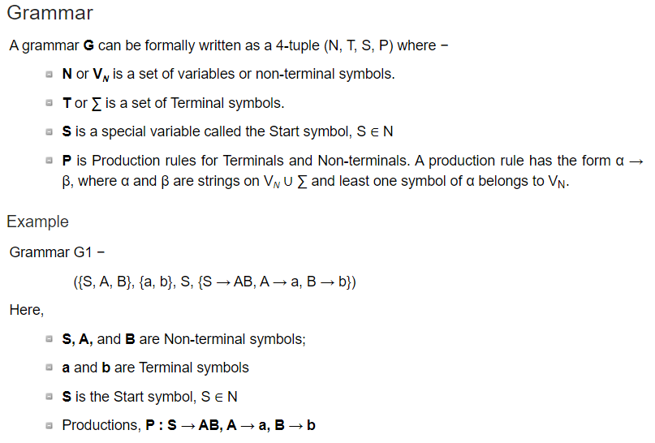
JSON is a way of specifying a GRAMMER for your Data
The Grammar of computer languages.

Slide 29
How does this relate to data tagging with JSON?
What are all the things we need to know about a Student to model this TOPIC in DATA.
Now we are being Data Modelers!
Student.json
<student>
<studentnumber attrib:pk>
C949494
</studentnumber>
<studentname>
C949494
</studentnumber>
<programgroup>
2020S_MAD_T3_S2
</programgroup>
</student>
STUDENTS
Student number
Student name
Cell phone, address
Program Group 2020S MAD T3 S2
What if we could describe in Data what a STUDENT object is?
We can – this is called JSON. We use XML tags and an agreed up GRAMMER.
JSON DATA REPRESENTATION OF A STDUDENT OBJECT

Slide 30
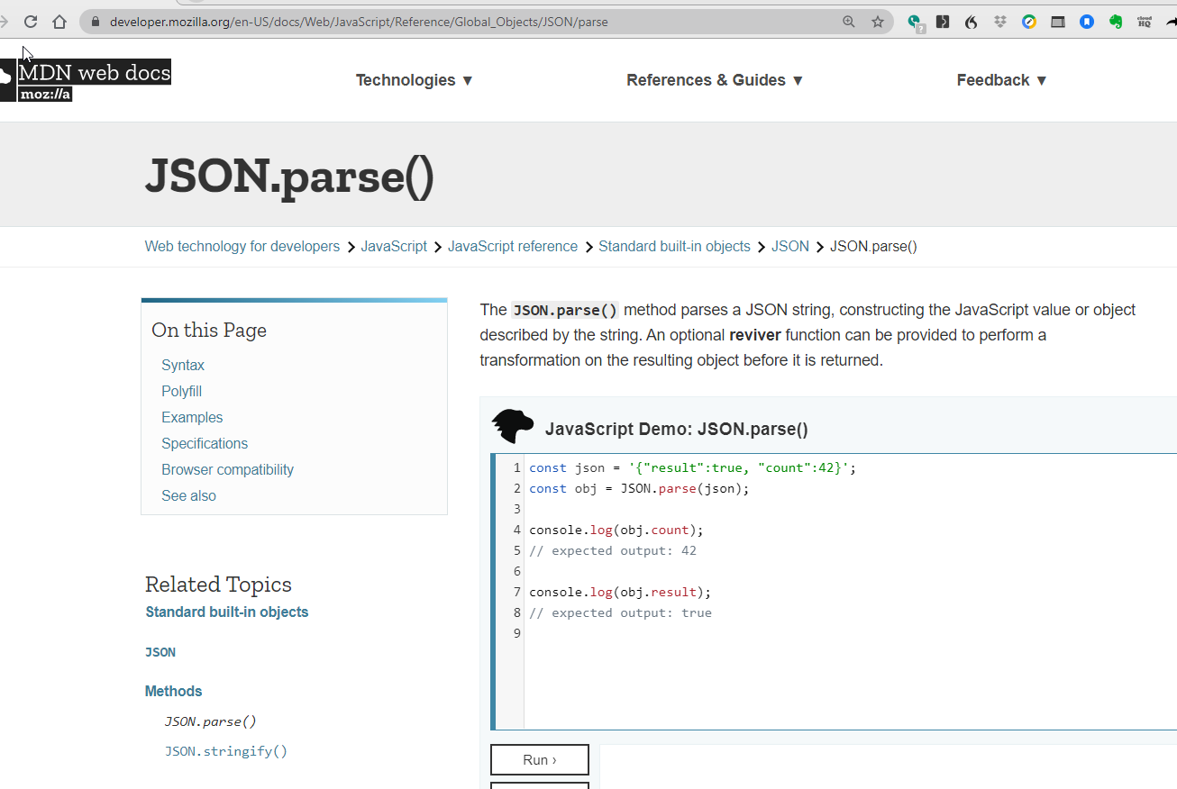
You can implement special handling of JSON data representations in JavaScript

Slide 31
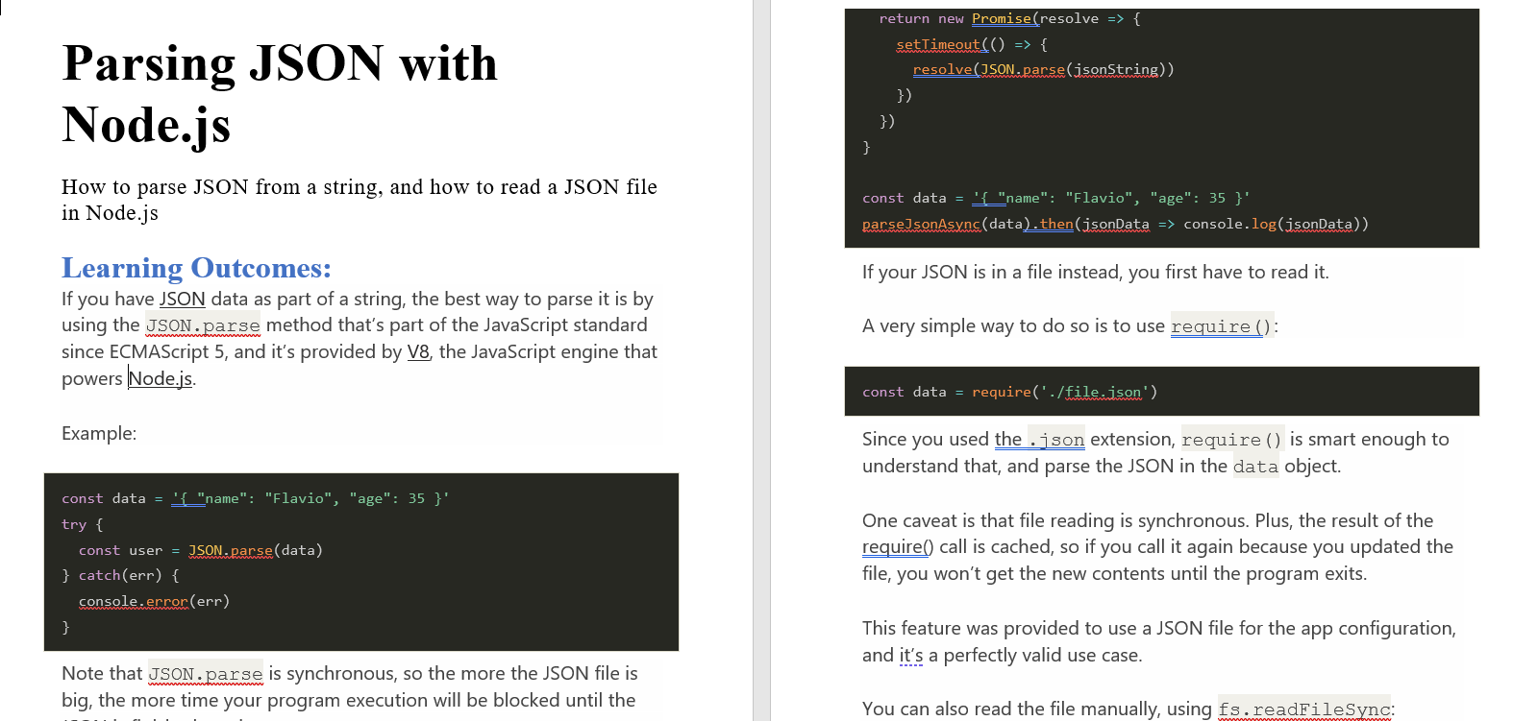

Slide 32
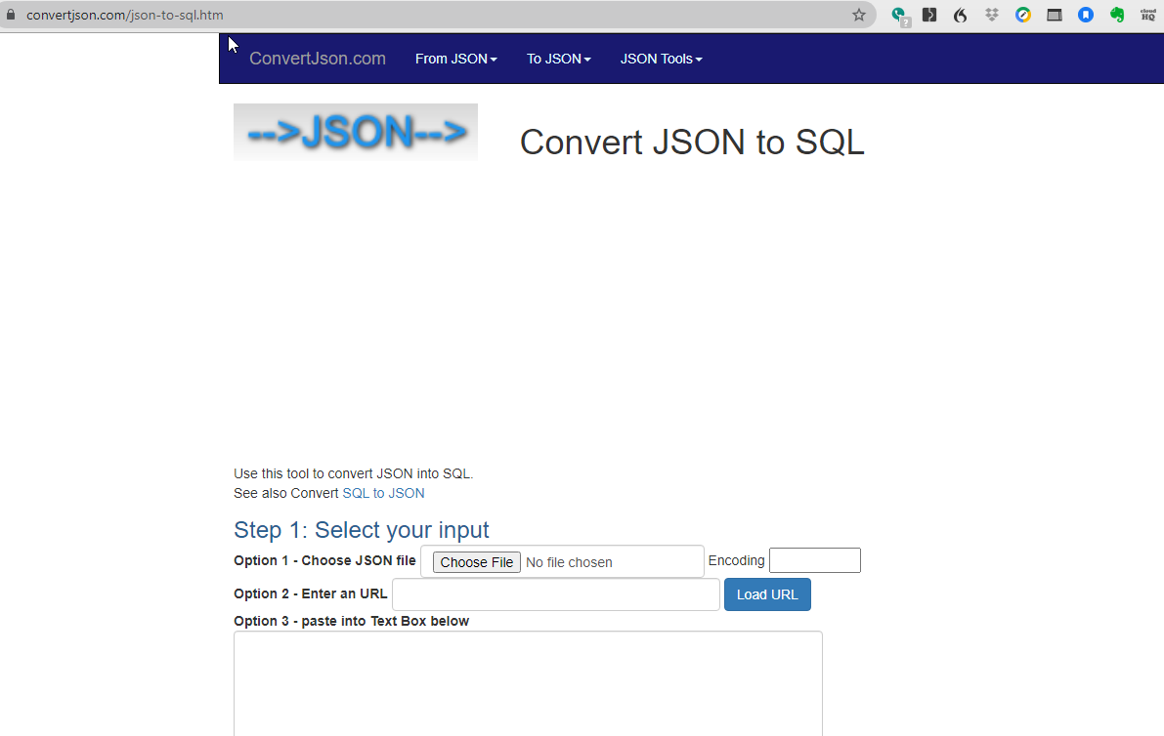

Slide 33

MONGO DB and the concept of the NOSQL Database
MONGO uses Document Collections not Tables with Rowsets, Fields and Primary Keys

Slide 34
MONGO DB is a NOSQL database
To understand what this means, let’s start by reviewing the concept of the SQL Database, Dr. Codd, and his famous 12 Laws!
Where does the Relational Database Model break down?

Slide 35
The Database Schema
The database schema of a database is its structure described in a formal language supported by the database management system (DBMS).
The term "schema" refers to the organization of data as a blueprint of how the database is constructed (divided into database tables in the case of relational databases).
The formal definition of a database schema is a set of formulas (sentences) called integrity constraints imposed on a database.[citation needed] These integrity constraints ensure compatibility between parts of the schema. All constraints are expressible in the same language. A database can be considered a structure in realization of the database language.[1] The states of a created conceptual schema are transformed into an explicit mapping, the database schema. This describes how real-world entities are modeled in the database.
"A database schema specifies, based on the database administrator's knowledge of possible applications, the facts that can enter the database, or those of interest to the possible end-users."[2] The notion of a database schema plays the same role as the notion of theory in predicate calculus. A model of this "theory" closely corresponds to a database, which can be seen at any instant of time as a mathematical object. Thus a schema can contain formulas representing integrity constraints specifically for an application and the constraints specifically for a type of database, all expressed in the same database language.[1] In a relational database, the schema defines the tables, fields, relationships, views, indexes, packages, procedures, functions, queues, triggers, types, sequences, materialized views, synonyms, database links, directories, XML schemas, and other elements.
A database generally stores its schema in a data dictionary. Although a schema is defined in text database language, the term is often used to refer to a graphical depiction of the database structure. In other words, schema is the structure of the database that defines the objects in the database.

Slide 36
Mongo changes around the paradigm of how to classify, sort, search, and retrieve data

Slide 37
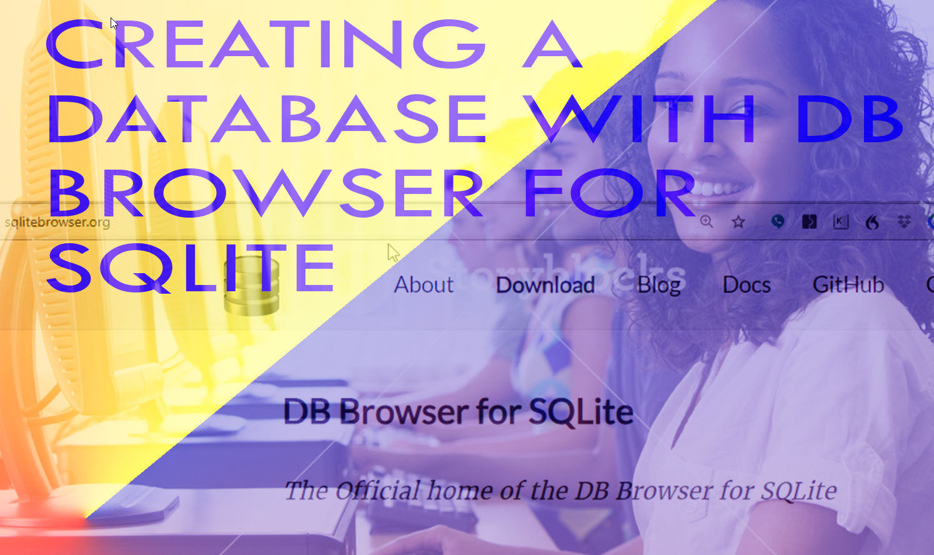

Slide 38
a simple review of SQL technology :
Let’s take some real estate data
Let’s import it into our SQL database
Then let’s see how to do a SQL pull (query) on our SQL data store
Let’s start with a simple review of SQL technology

Slide 39
a simple review of SQL technology :
What is the basis of how SQL works:
Codd’s 12 Laws: Download the PDF
Thomas Codd in 1972 wrote a paper stating what the Ideal container for data would like:
He said:
Data captured into TABLES
Table is MATRIX in the sense of an Algebra Matrix
Rows = sets of data: they are called row sets
Columns = field names ???
Let’s do a simple example of designing a database with EXCEL
HINT: This would be a GREAT design diagram in your PPTX for your Project.

Slide 40
A database consists of WHAT PIECES?
Tables: FIELDS
Relations: primary key, foreign key
Schemas: is an organization structure (analogous to directories in a file system)
Stored Procedures
Queries: stored external to database as files

Slide 41
Business Processes or BUSINESS RULES for our College Enrollment System: This is our TO DO LIST
LET’S MAKE A CLEAR, SIMPLE SET OF STATEMENTS OF WHAT OUR COLLEGE ENROLLMENT SYSTEM SHOULD DO: DESIGN THE MODEL WHICH IS THE BUSINESS RULES
THE SYSTEM SHALL MAINTAIN A SQL TABLE OF AVAILABLE COURSES INDICATING COURSECODE, APPLICABLE PROGRAM AND TERM (1,2,3,4)
THE SYSTEM SHALL MAINTAIN A SQL TABLE OF STUDENTS SPECIFYING: STUDENTID, STUDENTNAME, PROGRAM, TERM
WE NEED A CLASSES TABLE TO RELATE COURSEID TO A CLASS WITH DATETIME, ROOMID, INSTRUCTOR
THE SYSTEM SHALL MAINTAIN A SQL TABLE SPECIFYING COURSES / TERM / PROGRAM GROUP FOR EACH COHORT: IE WHICH COURSES ARE REQUIRED BY EACH PROGRAM FOR EACH TERM
WE NEED A CLASS TABLE TO SPECIFY: DATETIME, INSTRUCTOR, ROOM NUMBER, CLASSID, COHERT OF STUDENTS IN THAT CLASS
ENROLLMENTS TABLE: IS WHAT CONNECTS 1 STUDENT TO A CLASS INSTANCE
IN THIS STAGE OF THE EXERCISE, WE ARE DESIGNING THE “MODEL” OF THE MODEL – VIEW – CONTROLLER: THE MODE IS CALLED THE MODEL BECAUSE IT IS THE BUSINESS AND THE BUSINESS RULES: IN THE 1960s, INFORMATICS SPECIALISTS SAID “I WORK IN THE DATA PROCESSING DEPARTMENT”: THE DATA IS THE FACTS OF THE SITUATION; THE RULES STATE HOW WE GENERATE THOSE FACTS INTO RESULTS IN THE REAL WORLD

Slide 42
Our Theme for all our Lab Activities is going to be to make a 3 Tier Model View Controller Application in Node.js TO CREATE A COLLEGE ENROLLMENT using: express.js: View component/ HTTP SERVER {SQLite or Mongo DB} The ‘CONTROLLER’ IS THE PART WE WRITE BY OURSELVES TO IMPLEMENT THE BUSINESS RULES OR THE BUSINESS PROCESSES OF THE APPLICATION

Slide 43
Lab Activity: A Simple Web Server with express.js

Slide 44
Node.js Frameworks
NodeJs is a single-threaded, concurrent asynchronous programming language which provides non-blocking I/O and event-driven architecture and was initially written by Rayn Dahl in 2009.

Slide 45
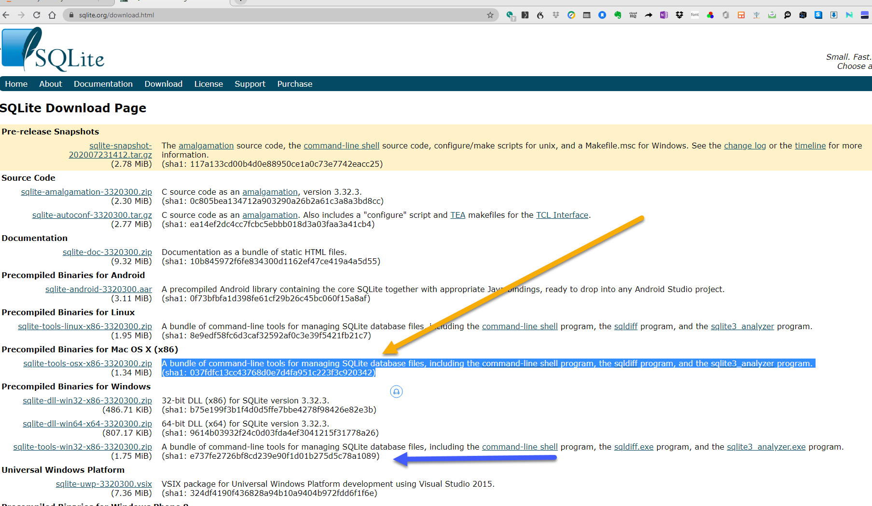
LAB ACTIVITY: DESIGNING THE SQLITE DATABASE
STEP 1: DOWNLOAD SQLITE AND SQLITE DB BROWSER:

Slide 46
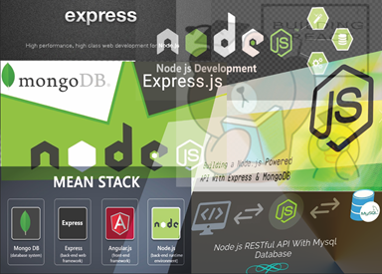
Course References and Resources
All Labs and Instructional Materials will be in Moodle in the Student Learning Materials Wiki.
Course PowerPoint Slides
Course Workbook: https://t2m.io/MAD6123_Course_Workbook
Because it is not practical to put large amounts of text in PowerPoint, I will be using the Course Workbook Google Doc as a primary channel to provide information to you.

Slide 47
Contract-based programming
In the context of writing software, contract-based programming means that I am structuring my code according to a specific format and protocol such that you can take it and use it.
The simplest example of Contract-based programming is writing a METHOD which becomes part of the PUBLIC API of your PRODUCT.
A API (= A PUBLIC METHOD) is an example of contract-based programming.
Your API is a guaranteed arrangement between me at the program and you as the user of my program that if you call my method with the proper input parameters, it is guaranteed to produce the correct result.

Slide 48
Issues related to server deployment and system administration:
The large context that the 12 Factor Model of App Design resides in is the ability to provision your code base to your users in an automated way
It makes sense that if we are going to create NODE.js Server applications, we should provide an automated mechanism for the users of our software to install and configure our application code.
You must factor System Administration considerations (HOW will your code get installed on / deployed to servers on the customers’ premises)

Slide 49
Thought stimulating Question:
In terms of the NODE.JS event loop:
How does Nodes JS EcmaScript Program running keep track of which returned EVENT OBJECT is connected to an event object that it dispatched?
If I dispatch 10 objects / and they are going to execute asynchronously – how do I know – when I start getting my callbacks on my promises – which callback is returning the object corresponding to the promise that I dispatched on to the EVENT QUEUE?

Slide 50
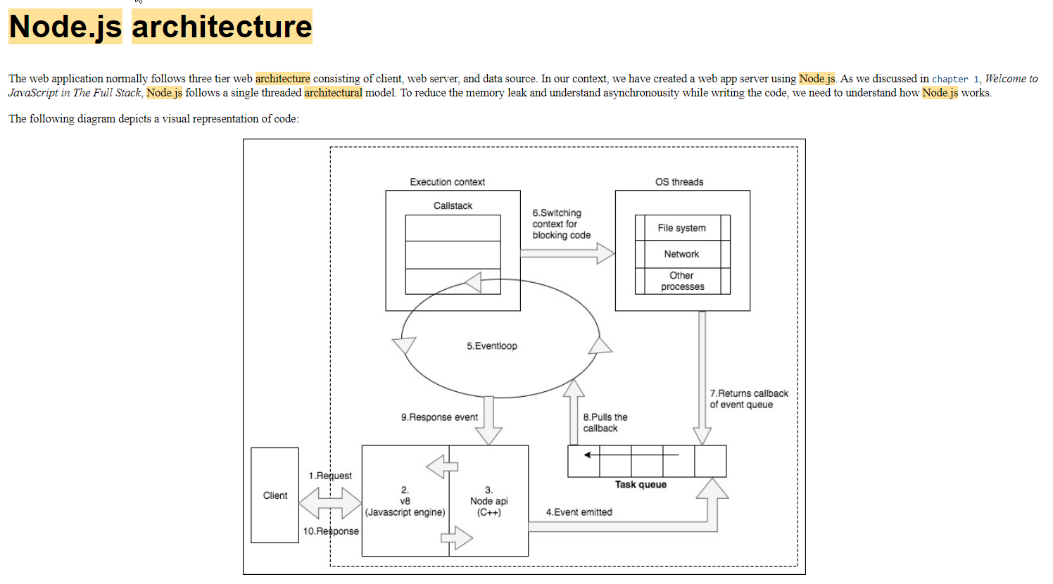

Slide 51
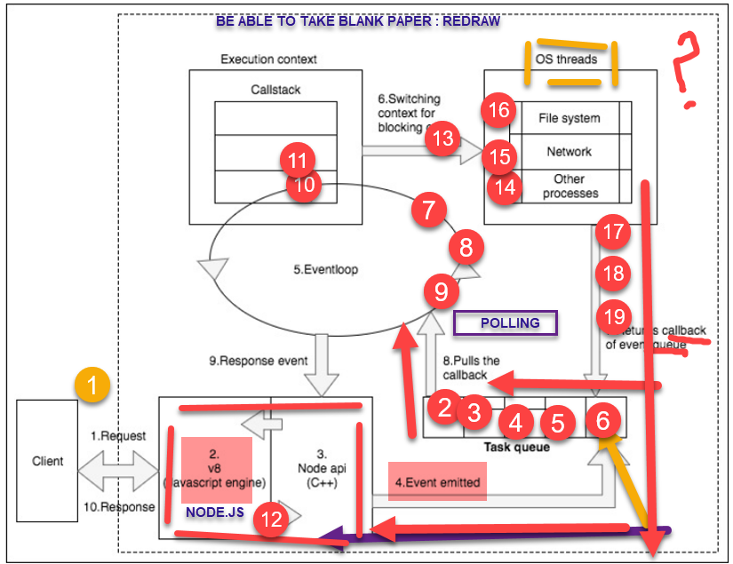
Visualizing how EVENT Objects move around the EVENT LOOP

Slide 52
Every processing component is sequenced in the following order"
The client sends a request (consider an HTTP request).
The Chrome's v8 engine is a just-in-time (JIT) compiler. Once the request is received at the server, v8 converts the JavaScript code to the machine code.
The C++ APIs within the Node.js core provide a binding for other system-level components. Binding is basically a wrapper library so that a code written in one language can communicate with a code written in another language. This API is responsible for emitting an event.
Once the event is emitted, it is stored in the event queue.
The eventloop is responsible for fetching the event from the queue and executing it in the callstack.
If an event requires an asynchronous operation to be done, such as using database files, it switches its execution context to another worker thread and gets executed. This is done by libuv. The libuv library is responsible for handling the asynchronous behavior of an event life cycle in the system. It is written in C. It maintains a pool of threads to handle asynchronous requests such as I/O and network-related operations.
Once the asynchronous operation is completed, it returns the callback. The callback remains in the event queue until the callstack gets empty.
Once the callstack is empty, the eventloop pulls the callback from the event queue and executes it in the callstack.
Eventually, the event returns the data to the Node API.
In each loop, it performs a single operation. Though the operations are performed sequentially, this single-threaded mechanized eventloop is so fast that it provides an illusion of concurrency. A single thread can utilize a single core of the system; hence, it provides better performance and minimal response time to client.

Slide 53
Event-driven
At its core, one of the most powerful features of Node is that it is event-driven. This means that almost all the code you write in Node is going to be written in a way that is either responding to an event or is itself firing an event (which in turn will fire other code listening for that event).
Example code: Connecting to a MongoDB server using Mongoose, a popular Node.js MongoDB Object Document Mapper (ODM) module:
mongoose.connect(');
mongoose.connection.on('open', function() {
console.log("Connected to Mongoose...");
});
First, we tell our mongoose object to connect to the server provided as a string parameter to the function. Connecting will take an undetermined amount of time though, and we have no way of knowing how long. So, what we do is bind a listener to the open event on the mongoose.connection object.
With the use of the on keyword, we are indicating that when the mongoose.connection object triggers an open event, it executes the anonymous function that was passed in as the parameter.

Slide 54
What are the 3 qualities of an OBJECT
Data fields
METHODS
OBJECTS Have unique ID: memory location where it lives in the HEAP
So JavaScript checks the IDs of the objects coming back in as callbacks from the dispatched promises. This is how the JavaScript Runtime Execution context knows which returning object is carrying the data that it was sent out to process.

Slide 55
JavaScript, TypeScript, BOM, Node.js
Working with TypeScript and JavaScript; Working with Node.exe and the BOM
Node.js and the Web Browser are 2 examples of Platforms.
Platforms provide SERVICES (APIs are an example of Services) that we can use in our Programs.
Browsers are a Platform.
Node.js is a Platform.
Both allow the running of JavaScript, but each provides different kinds of SERVICES as we discussed in class yesterday.
So, as to the Question of what KIND of JavaScript commands can I run the Browser or Node.exe – You can put any valid JavaScript you like, but if you call a Command that the Platform doesn’t support, you will get a RUNTIME ERROR. Because when the code is executing, it may attempt to call a SERVICE that the platform does not provide.
JavaScript Code
JavaScript Code
Web Browser: services provided by this platform accessing the Browser Object Model NODES
Node.js: accessing file system, accessing hardware resources
The Platform is the Execution Environment for the CODE. The Platform is the HOST software which is running Chromium v8 Engine that executes the JavaScript.

Slide 56
Questions:
Can I run JavaScript in Node.js | YES: JavaScript is run by the Chromium v8 Engine
What is the difference between JavaScript for the Browser and JavaScript for the Node.js context | You need to use only JavaScript or TypeScript that has commands that will work in the context you are working in: HTML DOM nodes cannot be accessed in Node.js The Host File System cannot be accessed from the Browser
 | The JavaScript is the same for both Browser and Node.js But different APIs are available in each Container. Use only the APIs for the container you are working in or you will run a RUNETIME ERROR!

Slide 57
The Browser Object Model is an in-memory datastructure that is created when an HTML Document is loaded into the Browser and processed by the Browser’s HTML Rendering Engine
Browser land
TypeScript: is a superset of JavaScript
The main difference is that TypeScript has static typing: a very strong advantage for designing the architecture of complex applications
JavaScript
When a JavaScript file is run in the Program Execution Context of the Chromium V8 JavaScript Interpreter Engine, the output is a ByteCode file that can run in the Operating System of the HOST COMPUTER.
Node.exe land

Slide 58
Putting it all together:
Node.js is a PROGRAM written in C++ which is wrapper for Chromium v8 JavaScript Interpeter Engine.
Which is a execution platform for our JavaScript
HOW?
Chromium v8 Engine
IDE:
Visual Studio Code
JetBrain
Eclipse
You could use Notepad, and Command Prompt
What does an IDE does:
Coding support (color highlighting, completion)

Slide 59
Difference between in-Browser JavaScript and JavaScript being run in Node.js
JavaScript has APIs to interact with the Browser Object Model
Node.js DOES HAVE any knowledge of BOM. It does NOT run in the Browser. It runs as a PROCESS in the Operating System.
HOW DOES NODE.js run ECMAScript outside the browser?
What is Node.exe ???
It is a program – Meaning it does run as an Operating System Process.
Ryan Dahl wrote Node.exe as C++ Program – Node.exe is Wrapper which uses the Chromium V8 Engine

Slide 60
Difference between JavaScript and Node.js
At its heart, it is a standalone JavaScript engine with extensions making it suitable for general purpose programming and with a clear focus on application server development.
it is simply a system to execute JavaScript programs.

Slide 61
Architecture of the Node.exe Application
JavaScript has APIs to interact with the Browser Object Model
Node.js DOES HAVE any knowledge of BOM. It does NOT run in the Browser. It runs as a PROCESS in the Operating System.
HOW DOES NODE.js run ECMAScript outside the browser?
What is Node.exe ???
It is a program – Meaning it does run as an Operating System Process.
Ryan Dahl wrote Node.exe as C++ Program – Node.exe is Wrapper which uses the Chromium V8 Engine

Slide 62
Architecture of the Node.exe Application
Operating System
Chrome Browser
JavaScript Interpreter:
Chromium v8 Engine:
Program that takes JavaScript and runs it
This is inside Chrome Browser
Access the BOM
Chromium v8 Engine:
Here we have APIs to access the BOM
Node.exe is a program written in C++
Access OS and hardware resources on host system
Chromium v8 Engine:
Here we have APIs to access host operating system resources:
File system
Database Connections

Slide 63
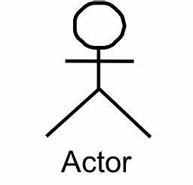
We want to be a WEB Backend Developer: WE ARE WRITING CODE TO HOST IT ON A SERVER
What is a 3 Tier Application?
Remember the Model View Controller
THE BACKEND IS YOUR LAPTOP; BECAUSE ALL THESE SERVERS ARE RUNNING ON YOUR LAPTOP
Model:
This is the DATA STORE:
SQLITE DATABASE
NO-SQL DB SUCH AS MONGODB;
OR API SUCH FIREBASE
PC OR MAC; LINUX
APPLE WATCH
IPAD
CRAY MAINFRAME
Controller:
This is the code that we write;
This implements the BUSINESS PROCESSES OF OUR APPLICATION: WE WILL PROGRAMS IN NODE.JS
View:
Our users interact with:
Could be phone screen or webpage :
HTTP SERVER: EXPRESS.JS

Slide 64
Day 01 Learning Outcomes:
Done: An introduction to Node.js
Why you should use Node.js
Writing JavaScript programs at the command line
Because it is a Network aware programming language with a huge base of support in the form of npm installable packages on NPMJS.org website.
The architecture of Node.js: Event Loop, Operating Dispatch Queue
Performance, utilization, and scalability with Node.js
Node.js, microservice architecture, and testing
Implementing the Twelve-Factor App model with Node.js

Slide 65
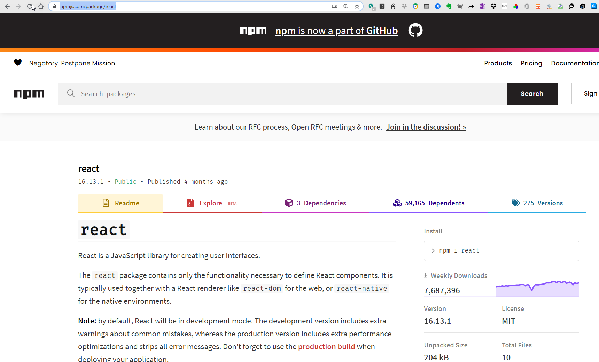
Why use Node?
Gives us a Coding environment to run JavaScript Code
We can npm (node package manager) to get access to the modules on npmjs.com

Slide 66
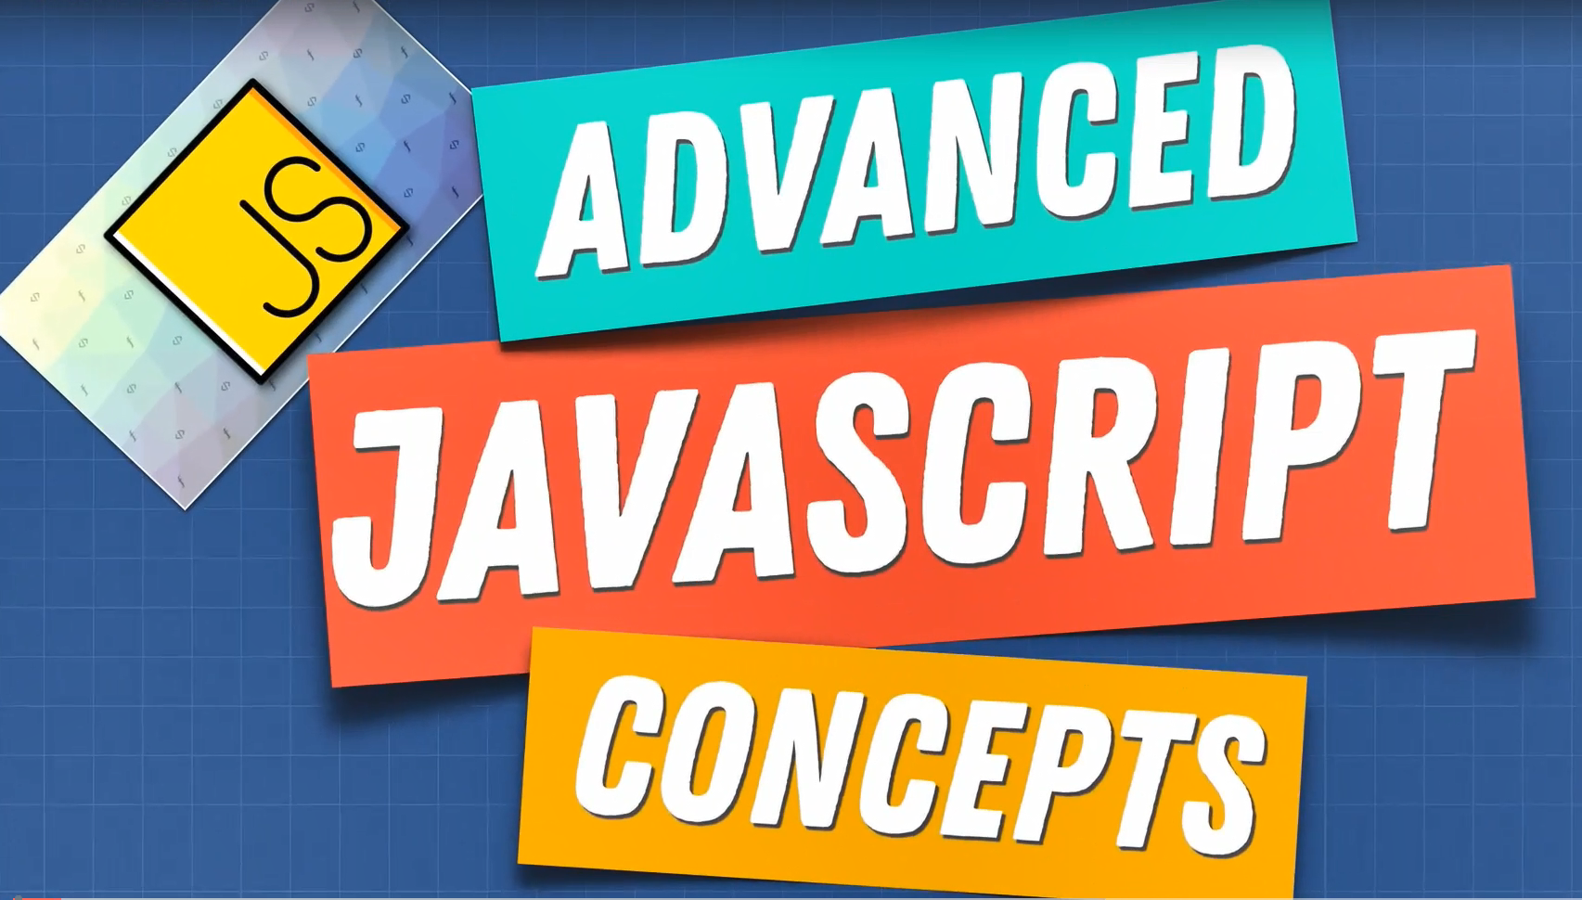

Slide 67
We will hit the ground running in this Course
We already know all of the basic concepts from our last courses:
Using JavaScript functions and classes
Using Visual Studio Code
Using Node and NPM
New topics in this course:
Hooking up the Database: Both SQL and NO-SQL databases
Building Web Servers. In our previous course we used web servers made by someone else. Here will BUILD OUR OWN webservers!
API Servers and Clients, and RESTful services

Slide 68
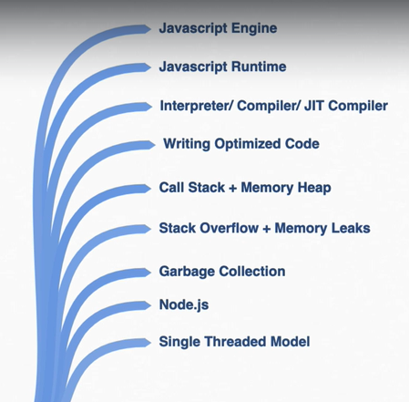
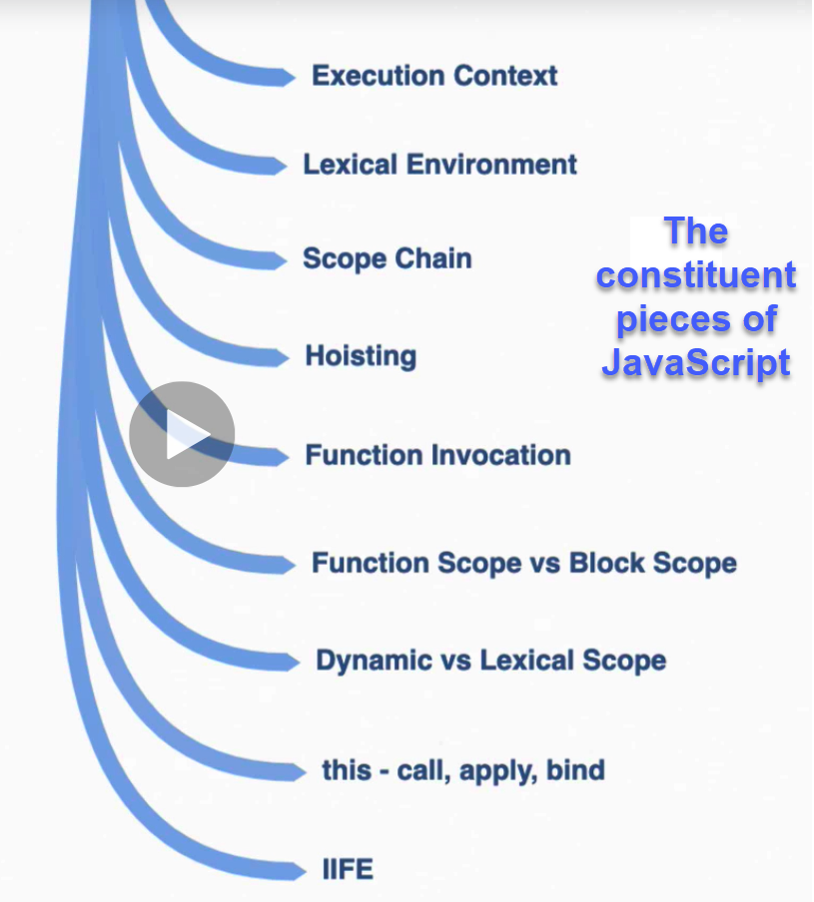

Slide 69
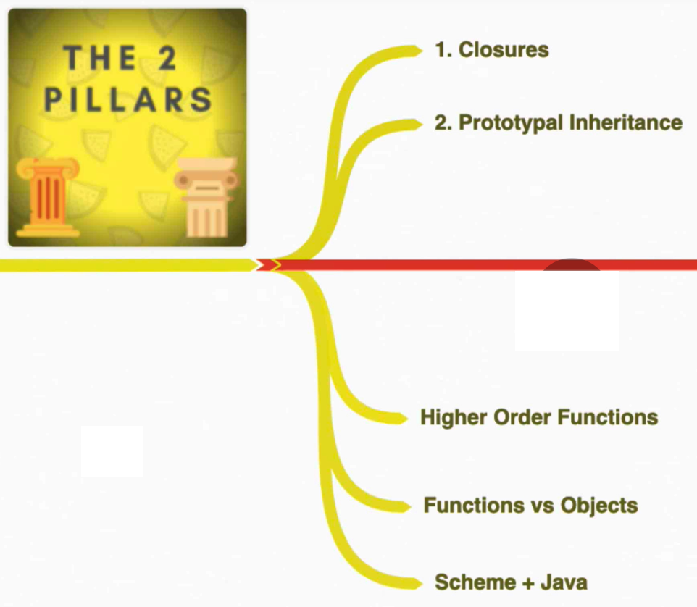
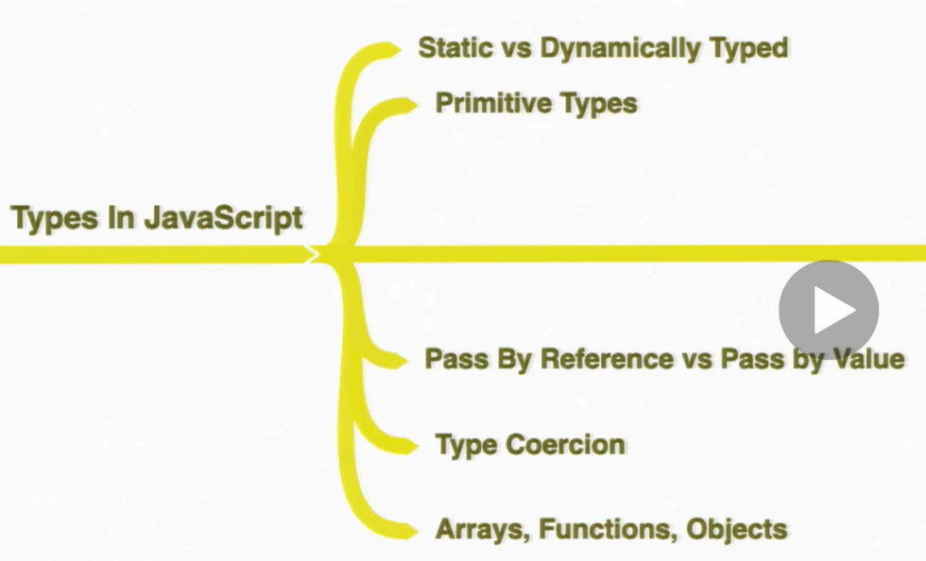

Slide 70
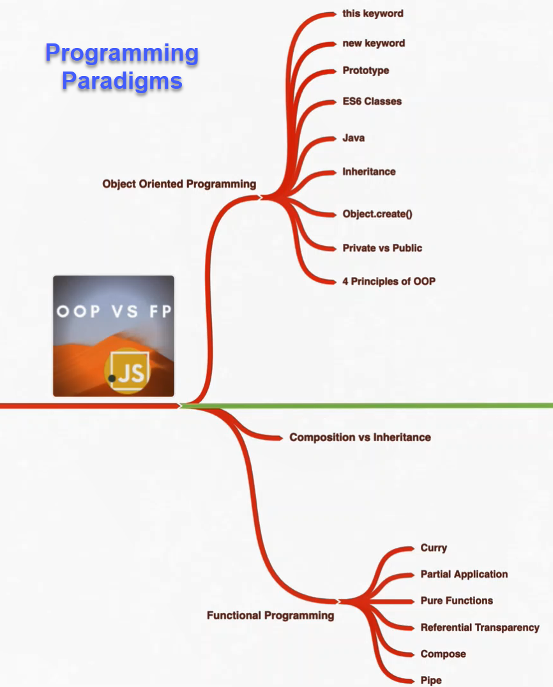

Slide 71
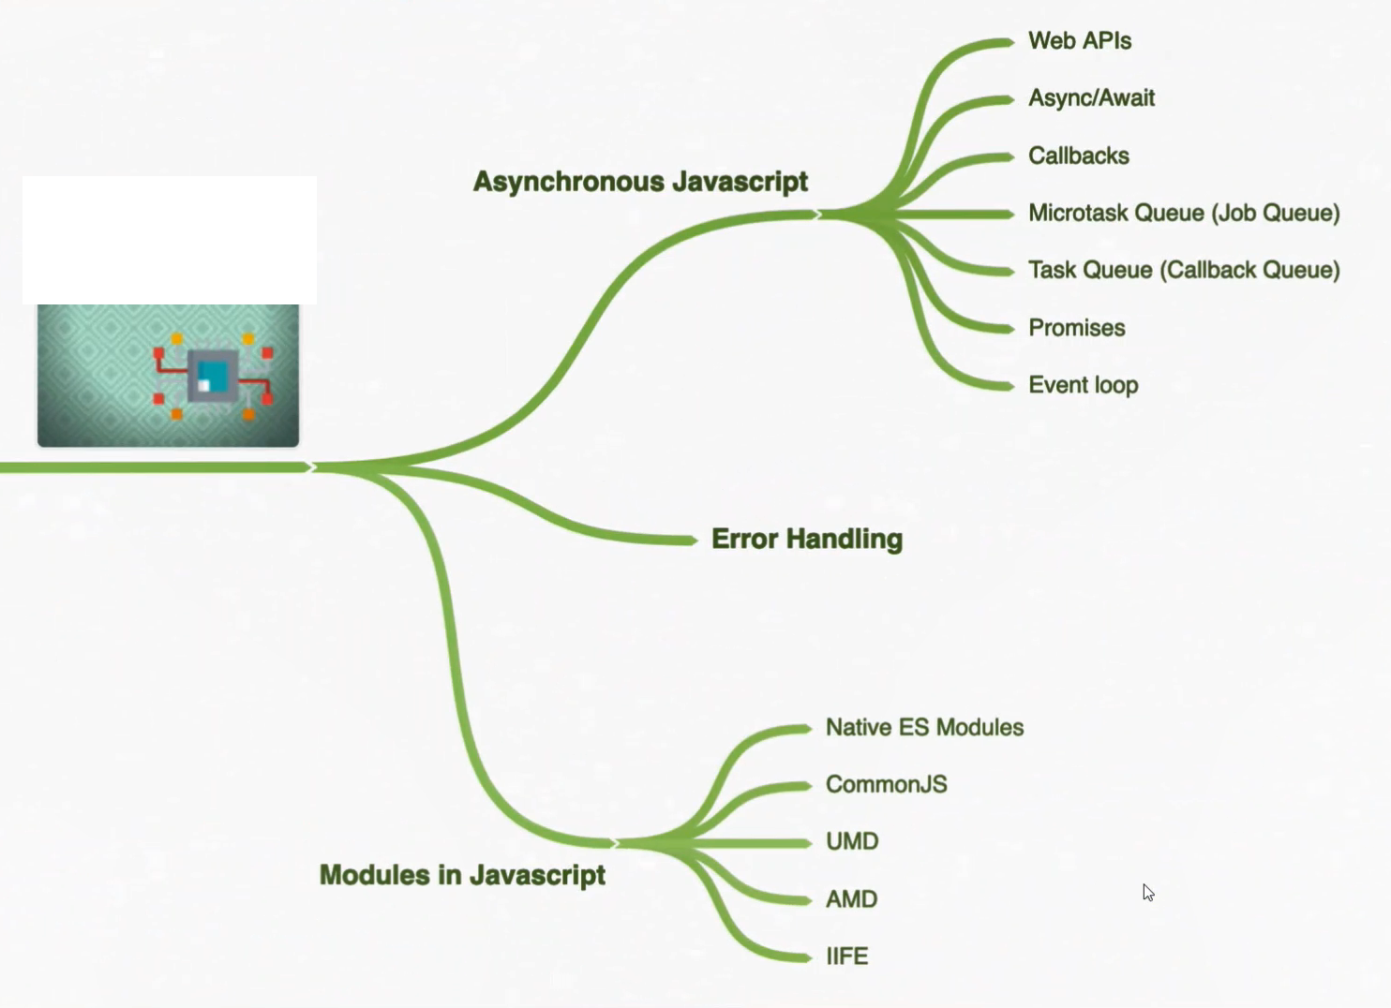

Slide 72
Developing with Docker: DEVOPS
Developers bring their ideas to life with Docker
Download Docker Desktop Sign Up for Docker Hub
Developing apps today requires so much more than writing code.
Multiple languages, frameworks, architectures, and discontinuous interfaces between tools for each lifecycle stage creates enormous complexity.
Docker simplifies and accelerates your workflow, while giving developers the freedom to innovate with their choice of tools, application stacks, and deployment environments for each project.

Slide 73
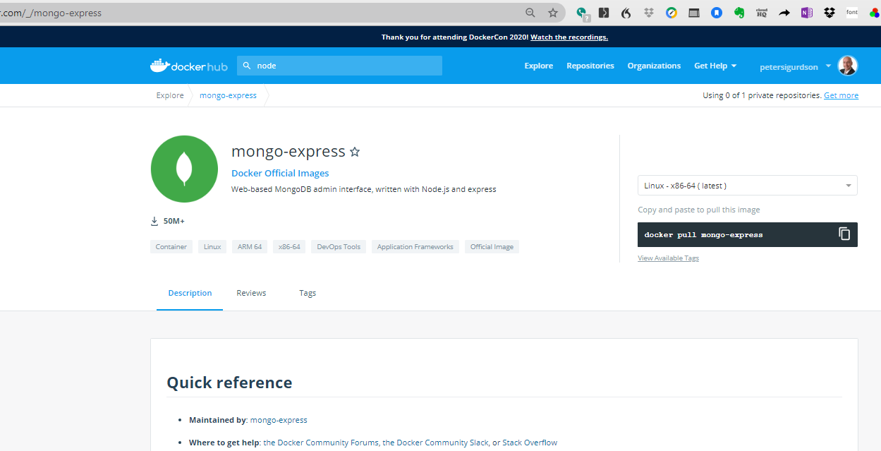

Slide 74
What does it mean to “dockerize” your application?

Slide 75

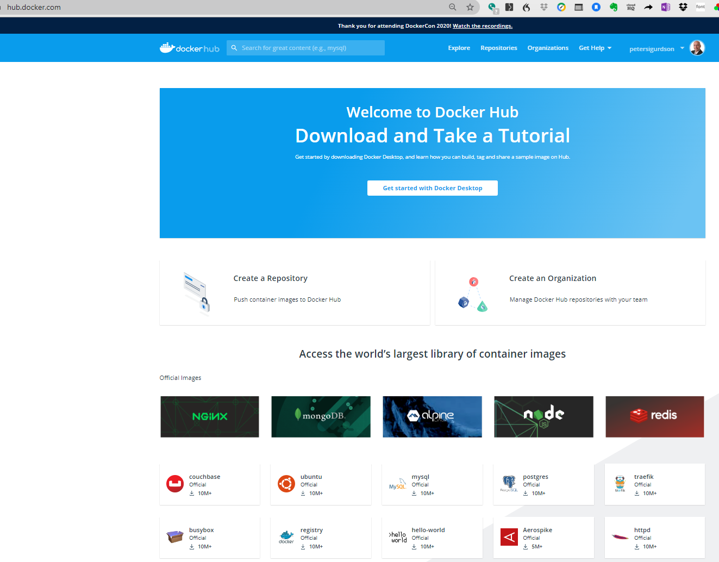
Class Activity: Sign up for a DOCKER Account
Let’s see what Docker is used for:
https://docs.docker.com/docker-hub/

Slide 76

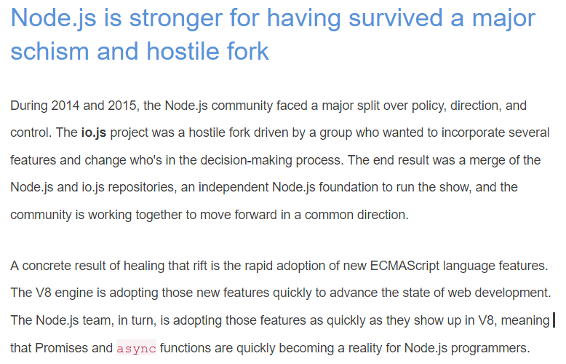

Slide 77
We already know what Node.js is. How does it connect to building web services?
As we discussed in our previous classes, Node.js is JavaScript
It runs as an Operating System process within a Shell Wrapper called Chromium v8
JavaScript is a very popular, powerful, and extensible programming language. It is in the top 5 languages employers are looking for.
So we have lots of skilled JavaScript talent to call on to build our Enterprise applications.
JavaScript was built from the ground up to live on the network

Slide 78
Node.js and the Twelve-Factor app model
Throughout this course, we will build our projects to the Twelve-Factor App model, and ways to implement those ideas in Node.js. This model is published on http://12factor.net, and is a set of guidelines for application deployment in the modern cloud computing era. It's not that the Twelve-Factor App model is the be-all and end-all of application architecture paradigms.
It's a set of heuristics. It is a set of best practices and proven design patterns created by practitioners as a result of many years of seeing things work and not work.
These offer useful ideas that could save us all a lot of effort by having easier-to-maintain and more reliable systems.
The guidelines are straightforward, and once you read them. They will seem like pure common sense.
As a best practice, the Twelve-Factor App model is a compelling strategy for delivering the kind of fluid self-contained cloud-deployed applications called for by our current computing environment.
https://12factor.net/

Slide 79

Some examples of the kinds of Lab Exercises we will be doing

Slide 80
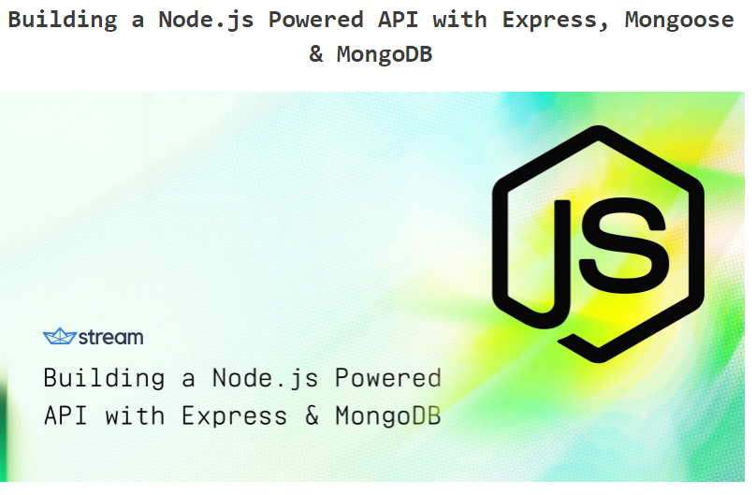

Slide 81
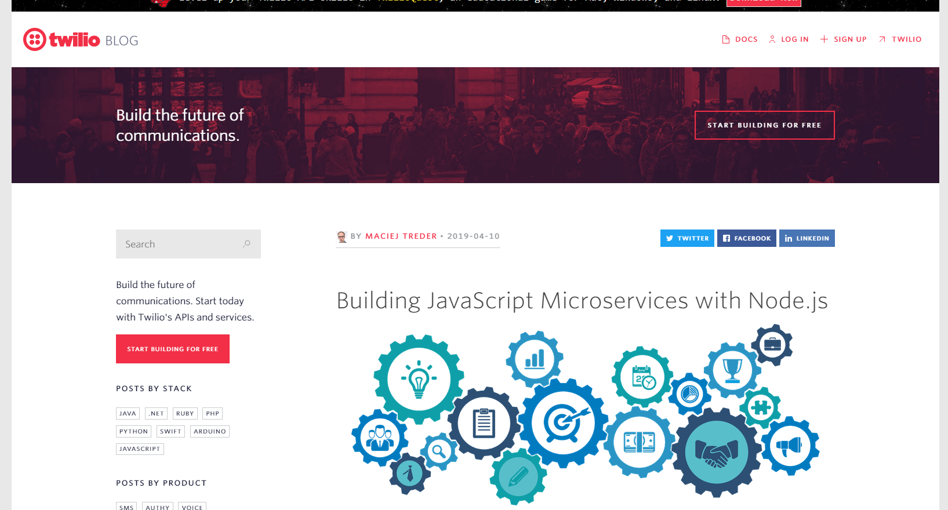

Slide 82
Using express.js

Slide 83

Some tools we will be using
Node
Node Package Manager (npm)
Visual Studio Code (you need to download and install this)
Npmjs.com (setup an account)
GITHUB (setup an account)

Slide 84
Review your Lab Worksheets for details on this
Architecture of Node.js
How To Build MVC Architecture In Node Js Applications?
Node Frameworks – examples: express.js
Building the Data Model: Using the Model-View-Controller (MVC) architecture
Architecture of a web application that uses NODE.js
Building Server side components: Node.js and the express package
Web Services: RESTful Services and Web APIs.

Slide 85
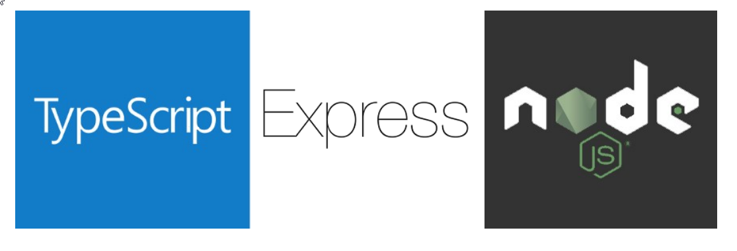
How (and why) you should use Typescript with Node and Express

Slide 86
TypeScript
“TypeScript is JavaScript for application-scale development”. That is, the work we have with the initial setup of the project is compensated with the maintainability of complex projects.
Properly implemented Class Prototypes and Object Orientation
CODE INTROSPECTION: The IDE exposes the project modules more easily
In complex projects we have hundreds of classes distributed across multiple files. When we define types, the IDE is able to relate objects and functions to the files that gave origin to them.
When using control + click on a method or class, imported from another file, the IDE will automatically navigate to the imported file, highlighting the line where the reference was defined.

Slide 87
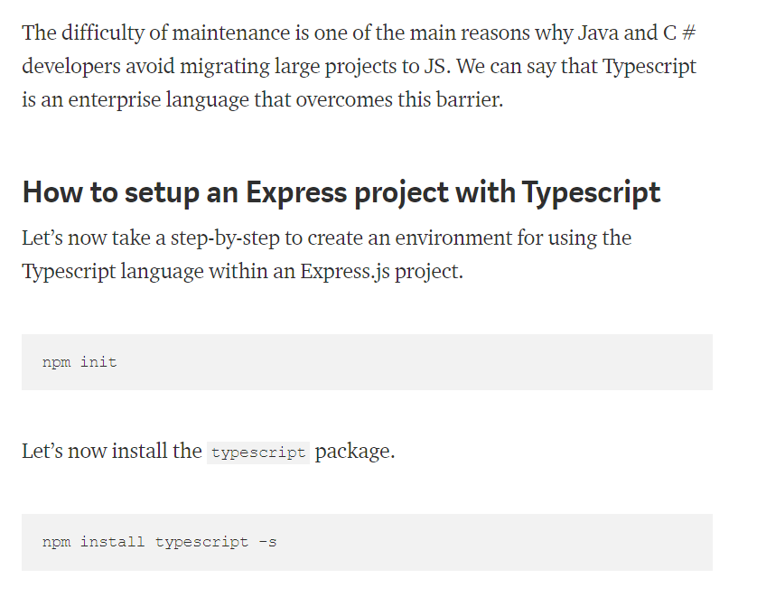

Slide 88
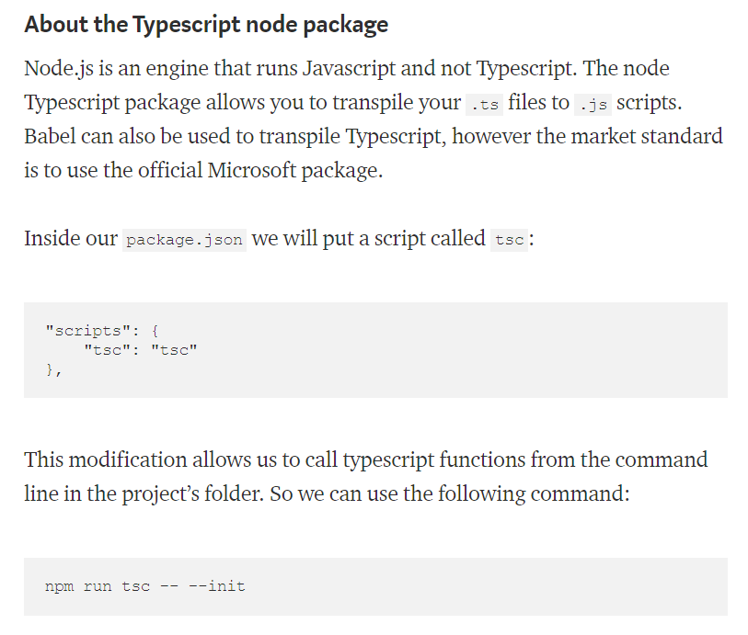

Slide 89
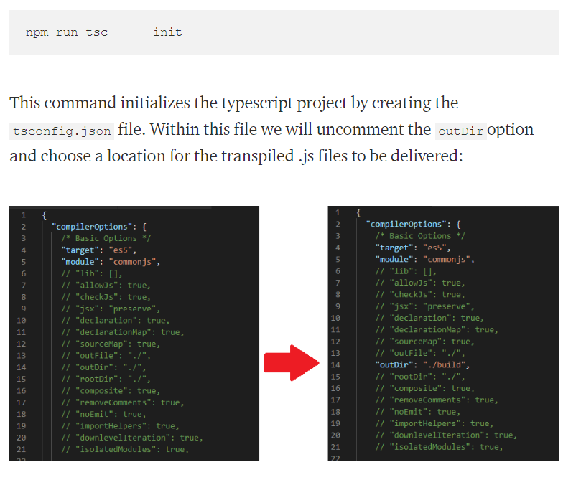

Slide 90
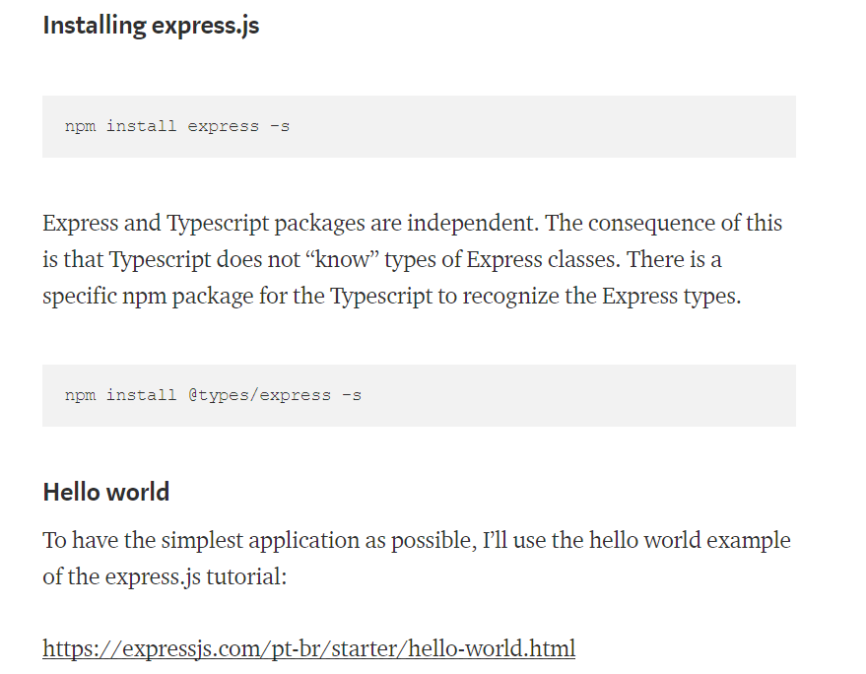

Slide 91
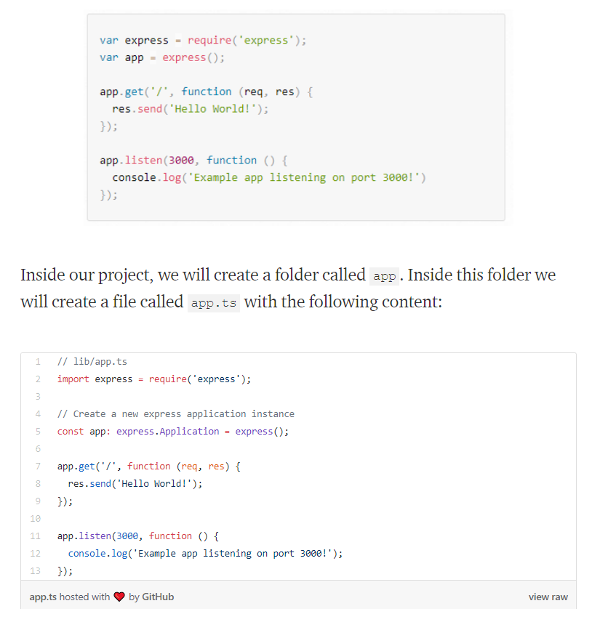

Slide 92
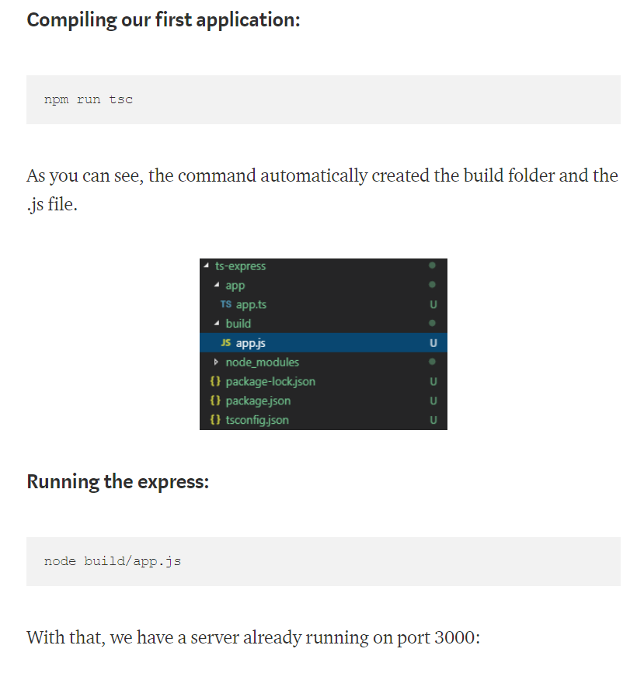

Slide 93
TypeScript References:
https://www.tutorialspoint.com/typescript/typescript_overview.htm
https://www.typescriptlang.org/docs/handbook/typescript-in-5-minutes.html
https://www.typescriptlang.org/docs/home.html

Slide 94
Advances in the JavaScript language
Embracing The last couple of years have been an exciting time for JavaScript programmers. The TC-39 committee that oversees the ECMAScript standard has added many new features, some of which are syntactic sugar, but several of which have propelled us into a whole new era of JavaScript programming. By itself, the async/await feature promises us a way out of what's called Callback Hell, or the situation we find ourselves in when nesting callbacks within callbacks. It's such an important feature that it should necessitate a broad rethinking of the prevailing callback-oriented paradigm in Node.js and the rest of the JavaScript ecosystem.
This was an important insight on Ryan Dahl's part, and is what propelled Node.js's popularity. Certain actions take a long time to run, such as database queries, and should not be treated the same as operations that quickly retrieve data from memory.
Because of the nature of the JavaScript language, Node.js had to express this asynchronous coding construct in an unnatural way. The results do not appear at the next line of code, but instead appear within this callback function. Further, errors have to be handled in an unnatural way, inside that callback function.

Slide 95

Difference between TypeScript and JavaScript:
TypesScript is known as Object oriented programming language whereas JavaScript is a scripting language.
TypeScript has a feature known as Static typing but JavaScript does not have this feature.
TypeScript gives support for modules whereas JavaScript does not support modules.

Slide 96
About Node.js
Node.js is an exciting new platform for developing web applications, application servers, any sort of network server or client, and general purpose programming. It is designed for extreme scalability in networked applications through an ingenious combination of server-side JavaScript, asynchronous I/O, and asynchronous programming. It is built around JavaScript anonymous functions, and a single execution thread event-driven architecture.
While only a few years old, Node.js has quickly grown in prominence and it's now playing a significant role. Companies, both small and large, are using it for large-scale and small-scale projects. PayPal, for example, has converted many services from Java to Node.js.
The Node.js architecture departs from a typical choice made by other application platforms. Where threads are widely used to scale an application to fill the CPU, Node.js eschews threads because of their inherent complexity. It's claimed that with single-thread event-driven architectures, memory footprint is low, throughput is high, the latency profile under load is better, and the programming model is simpler. The Node.js platform is in a phase of rapid growth, and many are seeing it as a compelling alternative to the traditional web application architectures using Java, PHP, Python, or Ruby on Rails.
At its heart, NODE.JS is a standalone JavaScript engine with extensions making it suitable for general purpose programming and with the focus on application server development. Even though we're comparing Node.js to application server platforms, it is not an application server. Node.js is a programming run-time akin to Python, Go, or Java SE.
While there are web application frameworks and application servers written in Node.js, it is simply a system to execute JavaScript programs.

Slide 97
Microservice architecture
A new trend in software development is the microservice idea.
Microservices are focused on splitting a large web application into small, tightly-focused services that can be easily developed by small teams.
While they aren't exactly a new idea, they're more of a reframing of old client-server computing models, the microservice pattern fits well with agile project management techniques, and gives us more granular application deployment.
Node.js is an excellent platform for implementing microservices.

Slide 98
Node.js is implemented around a non-blocking I/O event loop and a layer of file and network I/O libraries, all built on top of the V8 JavaScript engine (from the Chrome web browser). The rapid performance and feature improvements implemented in Chrome quickly flow through to the Node.js platform. Additionally, a team of folks are working on a Node.js implementation that runs on top of Microsoft's ChakraCore JavaScript engine (from the Edge web browser). That would give the Node.js community greater flexibility by not being reliant on one JavaScript engine provider. Visit https://github.com/nodejs/node-chakracore to take a look at the project.
The Node.js I/O library is general enough to implement any sort of server executing any TCP or UDP protocol, whether it's domain name system (DNS ), HTTP, internet relay chat (IRC), or FTP. While it supports developing internet servers or clients, its biggest use case is in regular websites, in place of technology such as an Apache/PHP or Rails stack, or to complement existing websites. For example, adding real-time chat or monitoring existing websites can be easily done with the Socket. IO library for Node.js. Its lightweight, high-performance nature often sees Node.js used as a glue service.
A particularly intriguing combination is deploying small services using Docker into cloud hosting infrastructure. A large application can be divided into what's now called microservices that are easily deployed at scale using Docker. The result fits agile project management methods since each microservice can be easily managed by a small team that collaborates at the boundary of their individual API.

Slide 99
The capabilities of Node.js
Node.js is a platform for writing JavaScript applications outside web browsers. This is not the JavaScript we are familiar with in web browsers! For example, there is no DOM built into Node.js, nor any other browser capability.
Beyond its native ability to execute JavaScript, the bundled modules provide capabilities of this sort:
Command-line tools (in shell script style)
An interactive-terminal style of program that is Read-Eval-Print Loop (REPL)
Excellent process control functions to oversee child processes
A buffer object to deal with binary data
TCP or UDP sockets with comprehensive event-driven callbacks
DNS lookup
An HTTP, HTTPS and HTTP/2 client/server layered on top of the TCP library filesystem access
Built-in rudimentary unit testing support through assertions

Slide 100
The network layer of Node.js is low level while being simple to use. For example, the HTTP modules allow you to write an HTTP server (or client) using a few lines of code. This is powerful, but it puts you, the programmer, very close to the protocol requests and makes you implement precisely those HTTP headers that you should return in request responses.
Typical web application developers don't need to work at a low level of the HTTP or other protocols. Instead, we tend to be more productive, working with higher-level interfaces. For example, PHP coders assume that Apache (or other HTTP servers) is already there providing the HTTP protocol, and that they don't have to implement the HTTP server portion of the stack. By contrast, a Node.js programmer does implement an HTTP server to which their application code is attached.
To simplify the situation, the Node.js community has several web application frameworks, such as Express, providing the higher-level interfaces required by typical programmers. You can quickly configure an HTTP server with baked-in capabilities such as sessions, cookies, serving static files, and logging, letting developers focus on their business logic. Other frameworks provide OAuth 2 support, and focus on REST APIs.
Node.js is not limited to web service application development. The community around Node.js has taken it in many other directions,

Slide 101
Node.js eco-system
Build tools: Node.js has become a popular choice for developing command-line tools used in software development, or communicating with service infrastructure. Grunt and Gulp are widely used by frontend developers to build assets for websites. Babel is widely used for transpiling modern ES-2016 code to run on older browsers. Popular CSS optimizers and processors, such as PostCSS, are written in Node.js. Static website generation systems such as Metalsmith, Punch, and AkashaCMS, run at the command line and generate website content that you upload to a web server.
Web UI testing: Puppeteer gives you control over a headless-Chrome web browser instance. With it, you can develop Node.js scripts controlling a modern full-featured web browser. Typical use cases involve web scraping and testing web applications.
Desktop applications: Both Electron and node-webkit (NW.js) are frameworks for developing desktop applications for Windows, macOS, and Linux. These frameworks utilize a large chunk of Chrome, wrapped by Node.js libraries, to develop desktop applications using web UI technologies. Applications are written with modern HTML5, CSS3, and JavaScript, and can utilize leading-edge web frameworks, such as Bootstrap, React, or AngularJS. Many popular applications have been built using Electron, including the Slack desktop client application, the Atom and Microsoft Visual Code programming editors, the Postman REST client, the GitKraken GIT client, and Etcher, which makes it incredibly easy to burn OS images to flash drives to run on single-board computers.
Mobile applications: The Node.js for Mobile Systems project lets you develop smartphone or tablet computer applications using Node.js, for both iOS and Android. Apple's App Store rules preclude incorporating a JavaScript engine with JIT capabilities, meaning that normal Node.js cannot be used in an iOS application. For iOS application development, the project uses Node.js-on-ChakraCore to skirt around the App Store rules. For Android application development the project uses regular Node.js on Android. At the time of writing, the project is in an early stage of development, but it looks promising.
Internet of Things (IoT): Reportedly, it is a very popular language for Internet-of-Things projects, and Node.js does run on most ARM-based single-board computers. The clearest example is the NodeRED project. It offers a graphical programming environment, letting you draw programs by connecting blocks together. It features hardware-oriented input and output mechanisms, for example, to interact with General Purpose I/O (GPIO) pins on Raspberry Pi or Beaglebone single-board computers.

Slide 102
Server-side JavaScript
Back in the dawn of the web age, the tools for writing web applications were at a fledgling stage. Some were experimenting with Perl or TCL to write CGI scripts, and the PHP and Java languages had just been developed. Even then, JavaScript saw use on the server side. One early web application server was Netscape's LiveWire server, which used JavaScript. Some versions of Microsoft's ASP used JScript, their version of JavaScript.
A more recent server-side JavaScript project is the RingoJS application framework in the Java universe. Java 6 and Java 7 were both shipped with the Rhino JavaScript engine. In Java 8, Rhino was dropped in favor of the newer Nashorn JavaScript engine.

Slide 103
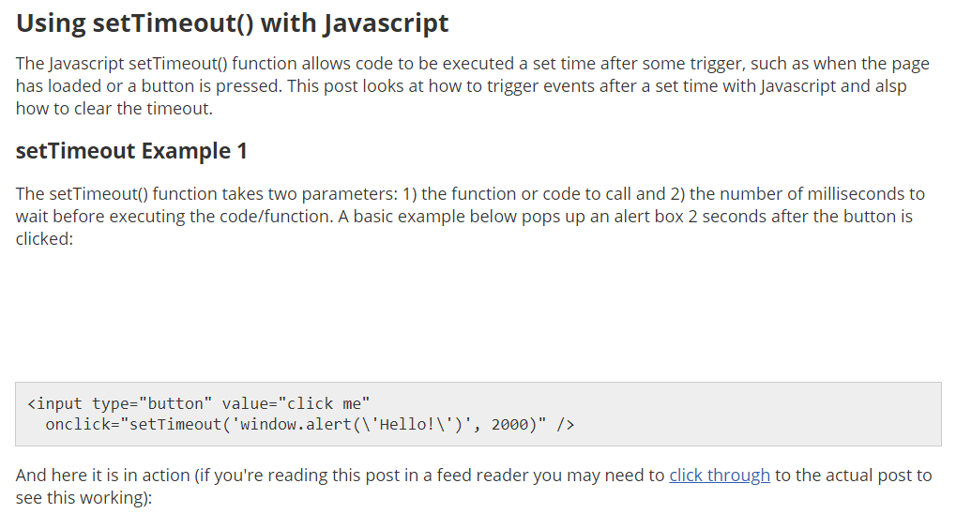

Slide 104
Asynchronous execution
Consider the idea of asynchronous JavaScript code in the browser using setTimeout;
the principles apply more strongly in the world of Node. As you may be making a number of network-dependent connections to different REST API services, database servers, and anything else, it is important that your code can be executed smoothly and has proper callback usage in place whenever each service responds.

Slide 105
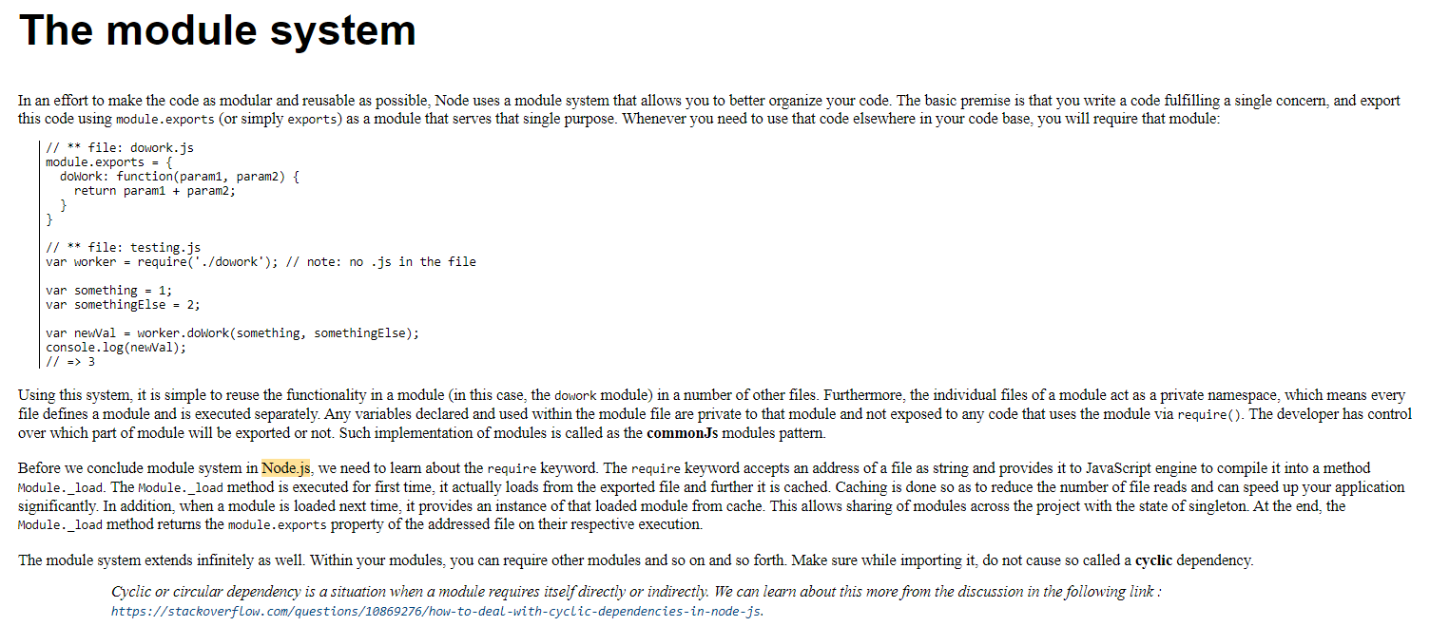

Slide 106
The Node.js core
The Node.js core literally has hundreds of modules available for you to use while writing your applications. These modules are already compiled into binary and are defined within Node.js source code. These include the following:
Events
Filesystems
Just like other languages, the Node.js core also provides an ability to interact with filesystem using the fs module.
This module is equipped with different methods for performing different operations on file synchronously as well as asynchronously. Refer chapter 1. Welcome to JavaScript in The Full Stack to learn more about the difference of sync and async. The synchronous methods of fs are suffixed by the keyword Sync for instance readFileSync.
For all reviewing the module in depth refer the following link : https://nodejs.org/api/fs.html.

Slide 107
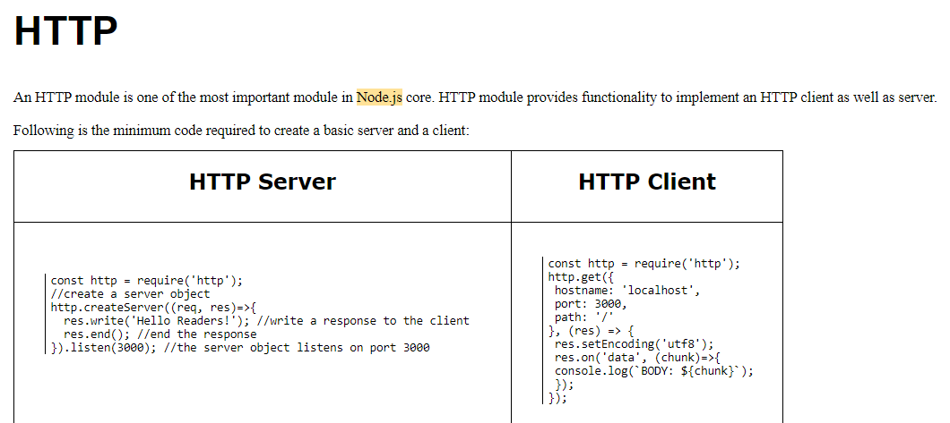

Slide 108
Common programming paradigms and how they apply to Node.js.
Understanding the Architecture of the Angular JS (Node.js) Application
express : This library will be used to expose our Web services(rest api).
express-list-endpoints: This library allows us to list our Web services.
my-sql: Mysql library allow us to communicate with our database.

Slide 109
Topic Preview
In this Module we will study the most common programming paradigms in Node.js:
how Node.js handles parallel requests.
how to write modules and make them communicative.
the problems of the asynchronous code and their most popular solutions.
how to construct our application.
With all this as a basis, we can start thinking about better programs. Software writing is not an easy task and requires strong knowledge and experience. The experience usually comes after years of coding; however, knowledge is something that we can get instantly. Node.js is a young technology; nonetheless, we are able to apply paradigms and concepts from client-side JavaScript and even other languages.

Slide 110
Node.js fundamentals
Node.js is a single-threaded technology.
This means that every request is processed in only one thread. In other languages, for example, Java, the web server instantiates a new thread for every request.
However, Node.js is meant to use asynchronous processing, and there is a theory that doing this in a single thread could bring good performance. The problem of the single-threaded applications is the blocking I/O operations; for example, when we need to read a file from the hard disk to respond to the client. Once a new request lands on our server, we open the file and start reading from it. The problem occurs when another request is generated, and the application is still processing the first one.

Slide 111
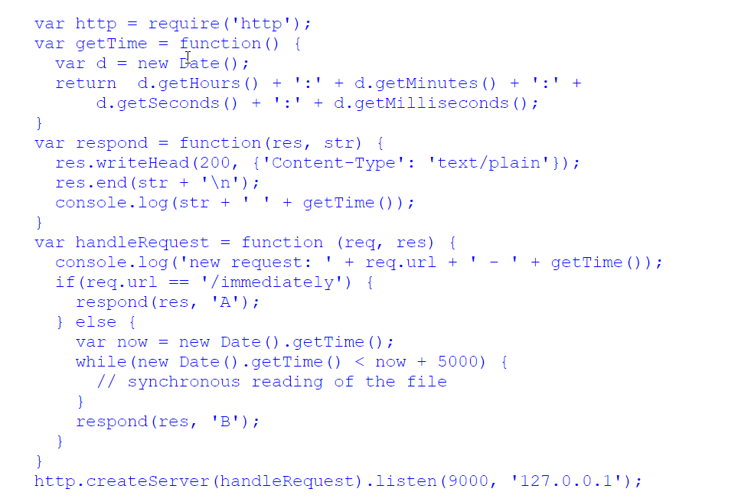

Slide 112
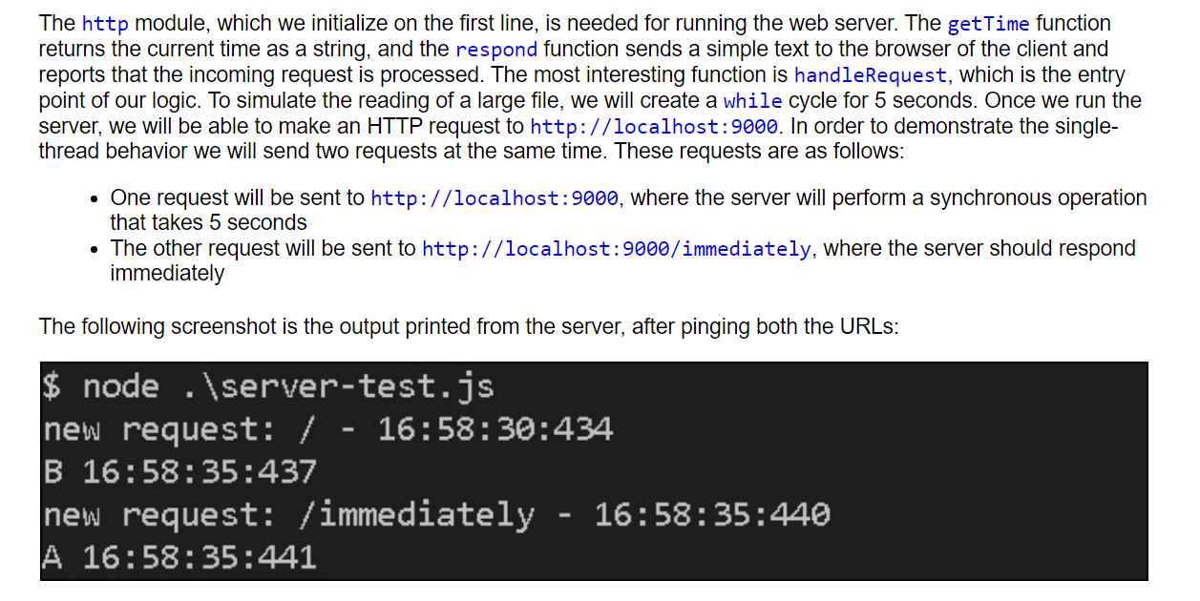

Slide 113
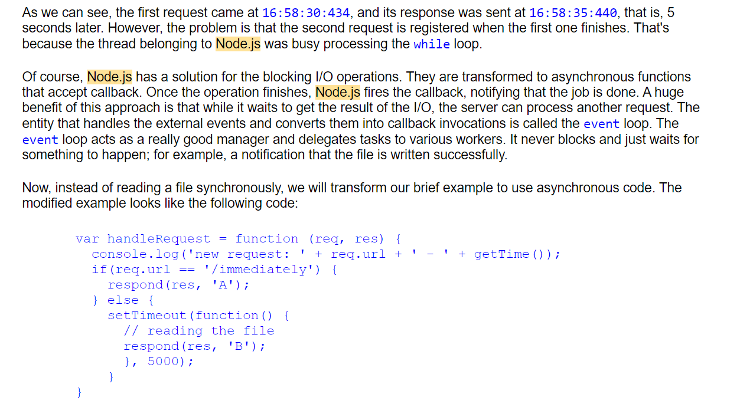

Slide 114
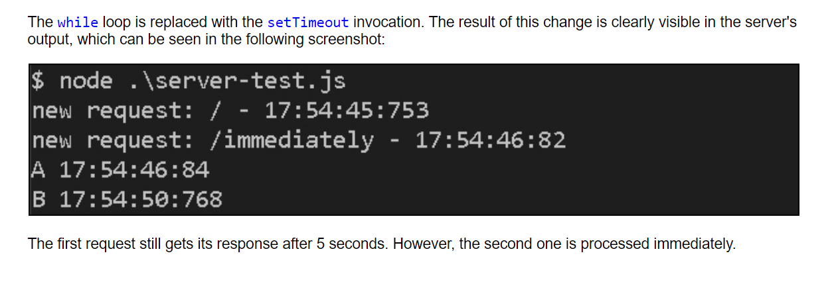

Slide 115
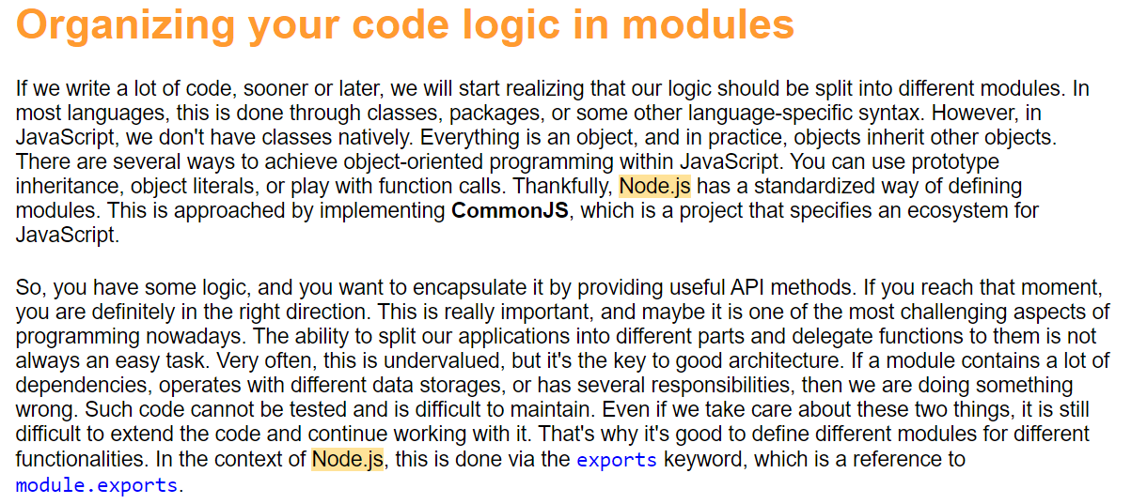

Slide 116
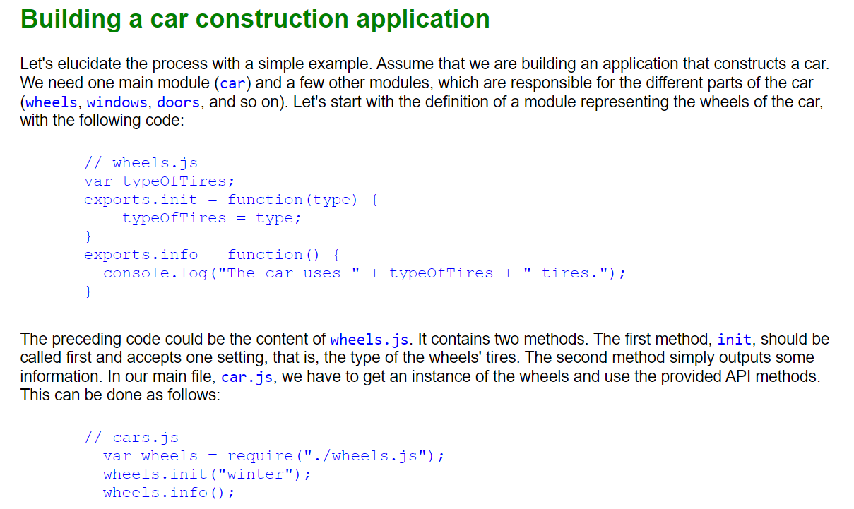

Slide 117
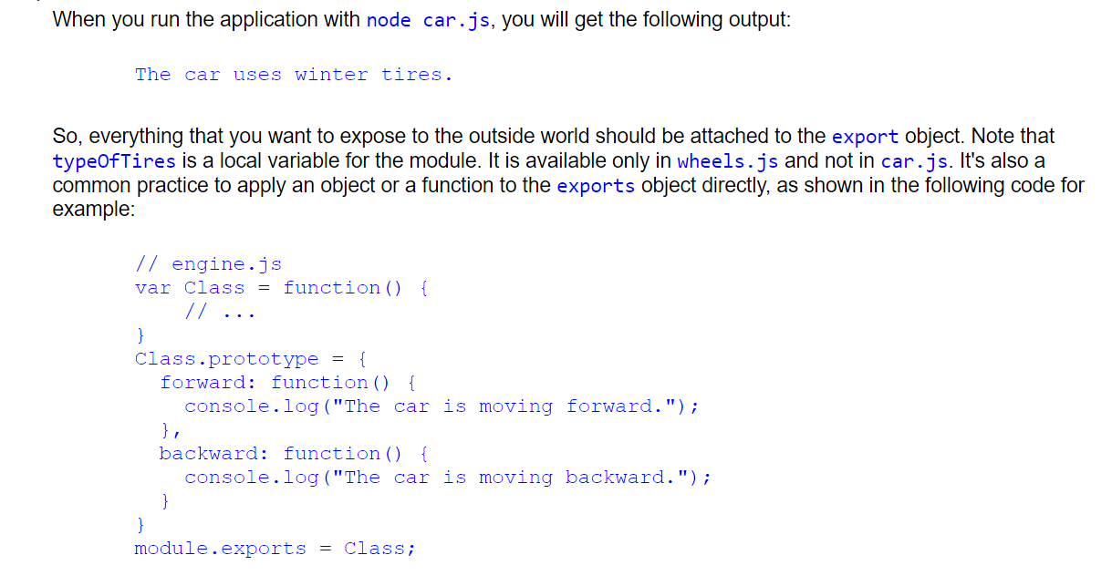

Slide 118
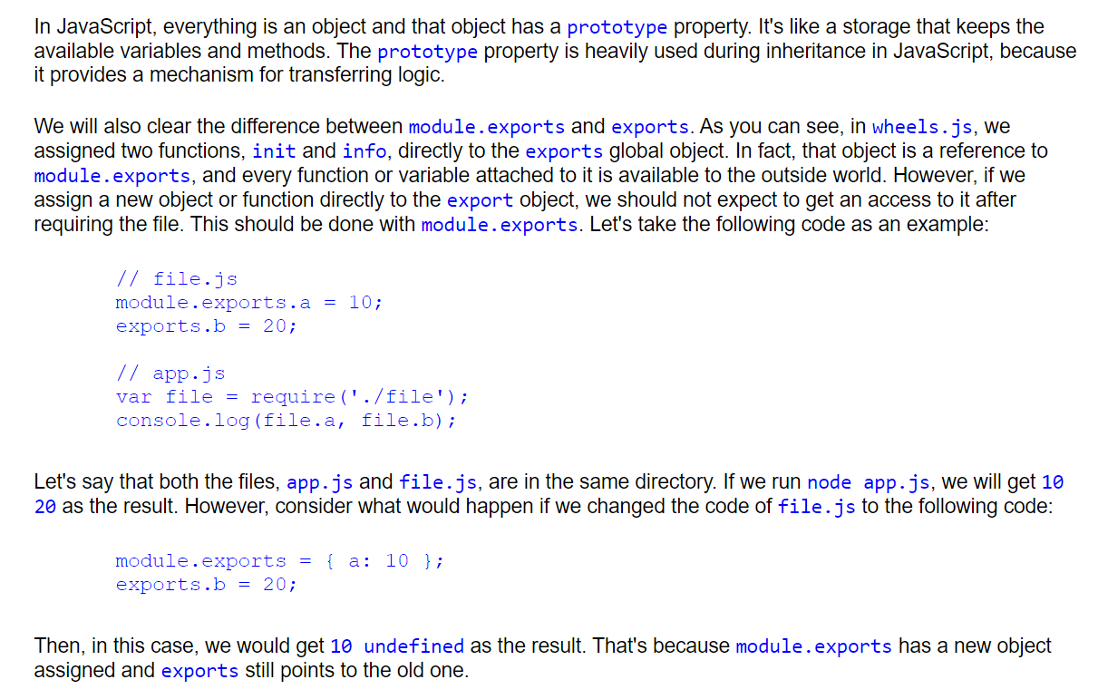

Slide 119
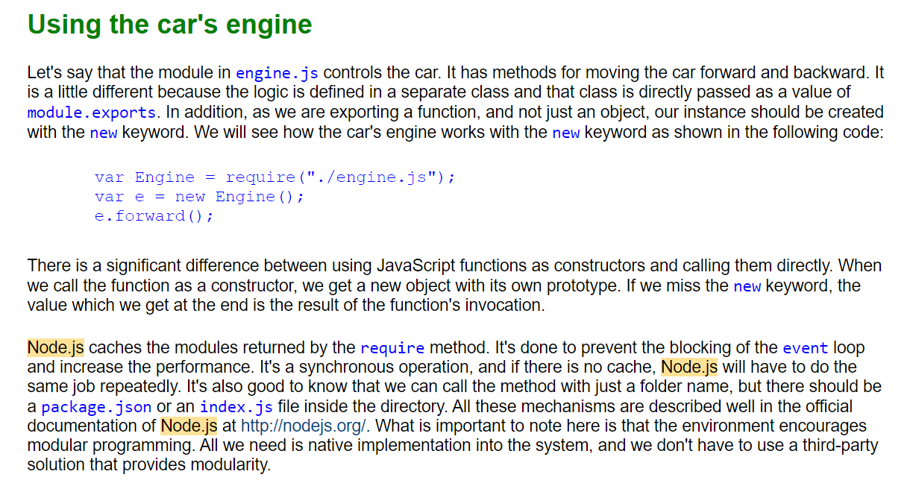

Slide 120


Slide 121


Slide 122


Slide 123


Slide 124


Slide 125


Slide 126


Slide 127


Slide 128


Slide 129


Slide 130


Slide 131


Slide 132


Slide 133


Slide 134


Slide 135


Slide 136
Developing a Basic Site with
Node.js and Express
Learning Outcome: The Express framework. It's one of the most popular frameworks available and is certainly a pioneering one. Express is still widely used and several developers use it as a starting point.

Slide 137


Slide 138
The Model View Controller Application
The Model is the Database
The View is the HTML Page
The Controller

Slide 139


Slide 140
var express = require('express');
var router = express.Router();
var bodyParser = require('body-parser');
router.use(bodyParser.json());
var Matiere = require('./Matiere');
router.get('/', function (req, res) {
Matiere.getmatieres(function(err,rows){
if(err) {
res.status(400).json(err);
}
else
{
res.json(rows);
}
});
});
router.post('/', function (req, res) {
Matiere.creatematiere(req.body,function(err,count){
if(err)
{
res.status(400).json(err);
}
else{
res.json(req.body);
}
});
});
module.exports = router;

Slide 141
How To Build MVC Architecture In Node Js Applications?

Slide 142
Node.js Frameworks
NodeJs is a single-threaded, concurrent asynchronous programming language which provides non-blocking I/O and event-driven architecture and was initially written by Rayn Dahl in 2009.

Slide 143

Understanding the Event Loop

Slide 144
Understanding the Event Loop
Event-loop is one of the most important features of NodeJs framework which also explains how exactly the code gets executed in the Node environment.
Event Loop comes with the stack, some web APIs and callback queue.
The Event-loop is an endlessly running single-threaded loop.

Slide 145
How does the Node.js Framework work
When we run a new chunk of code, it goes onto the stack for execution -- here is the twist which brings this whole non-blocking I/O model concept into the ground.
If a block of code that is going to be executed is an AJAX request, DOM operation or any other timeout function, then it is going to take time and Node.js is an asynchronous programming language so it’s not going to wait for the response of the AJAX call or for that matter the timeout function to get over completely, instead what it will do is, the respective chunk of code will move to callback queue which works on FIFO.
Meanwhile, the event-loop which has only one job to do is to check whether the stack is empty or executing any other block of code. The moment the event loop finds stack empty it moves the very first item queued in the callback queue to the stack and the process keeps repeating.
This is how Node.js manages to be a non-blocking I/O system and single-threaded at the same time which eventually makes it a very powerful, lightweight and efficient model.

Slide 146
Powered by Javascript V8 ENGINE :
The core functionalities of NodeJs reside in the JAVASCRIPT library.
The NodeJs bindings are written in c++ which connect these technologies to others and to the operating system.
NodeJs uses the libuv library to handle all the async operations. libuv (Unicorn Velociraptor Library) is a multi-platform C library which provides support for asynchronous I/O events for windows and POSIX based system such as macOS, Linux, and UNIX.
NodeJs runs on JAVASCRIPT V8 engine which was primarily designed for Google Chrome. The V8 engine is written in C++ and compiles JavaScript code to machine language.

Slide 148
HTML and XML
HTML is a Page Description Language: We can build CONTENT and control the display of the content on Web Brower Page
XML is a DATA DESCRIPTION language. XML is used to construct Classifiers and Designators to control the inter change of data between 2 parties. Think about a Business to Business Ecommerce website.

Slide 149
2 important concepts:
Chronos : Greek word: related to TIME
Synchronous: things happen together: Having a Web Form with a SUBMIT BUTTON: that means when I click the SUBMIT button, all the field data gets transmitted to the server program as one block at the same time. We can NOT have a SPA (Single Page Application) with this programming pattern. Synchronous operation means we have a central timing authority who is in charge of starting things going.
Asynchronous: Things do not happen in a way that is time-related with each other. Things happen without having wait for a request/response cycle with the server. Generally trigger by user actions.

Slide 150
How does any general Web Application Work
Model (backend): Database, API (http delivered web service to out to Azure Machine Learning to get some data, or some instructions)
Model relates to data, but not just data: The model can also serve up BUSINESS PROCESSES/Business Rules
The middleware: CONTROLLER: It is the Node.js Code we write to direct the execution of the program
Front end : Web Server: The customer connects in via their web browser with a URL.

Slide 151

There are 3 ways to make web applications
Request / Response Paradigm [Synchronous]: This works with HTML Forms. All the form data is transmitted to the SERVER FORM in 1 BLOCK synchronously (together at the same time) when the SUBMIT BUTTON IS CLICKED
2. The single page web application is ASYNCRONOUS: AJAX makes this possible! (So do other technologies like Java Enterprise Edition with Servers, JSPs, and EJBs).
What about Web Services APIs?

Slide 152
This is oldest (since 1993) way of setting up web applications
Middleware: CONTROLLER
Express.js
Request via a URL
Browser communicates with SERVER via HTTP
<Form action=is a url that activates a program on the server, we used routing>
Fields
Submit button
</form>
MODEL: Sqlite DB, Mongon, API call to Azure webservices
Sql
RESULT SET
response
When I get the response:
The server sends me back a new html page and my current is re-written
Processing
What is the limitation or bad thing about this way of doing things?

Slide 153


Slide 154

The Single Page Web application and AJAX makes this possible: We need to have a realtime connection between the client and the server. An example is the Angular JS SERVER.
Google Earth is an example of using AJAX (Asynchronous JavaScript and XML): We don’t have to click a submit button.
Google Earth and Google search (with look ahead completion) is an Example of a Single Page Web Application: It is asynchronous.
It does NOT have request/response cycle.
It maintains a REALTIME connection between the browser and the server
Think about a water pipe:
It comes out over here
We put something in this end
There is live real-time interaction via AJAX

Slide 155
Web Services APIs:
Suppose we a big application – All banks for example – have a lot of COBOL Applications. Very old legacy code. We do not want to re-write it. But we do want to make it WEB ENABLED.
How to solve this problem?
Here is all our “Legacy” code.
Old COBOL code for example
In this case, this is what is going on in the SERVER.
WE write a WRAPPER PROGRAM that “wraps up” our old legacy code, and we expose the METHODS to be accessible via HTTP Calls
WEB SERVER
Here is the web browser the client connects to:
Web Services APIs means that we write wrapper code that the web server can connect to methods, and the result of the method call is wrapped up a HTML and sent back to the SERVER.

Slide 156
Some other test topics:
Discuss the concept of the Node.js SERVER:
It uses like express.js
NODE.js works with the event loop. (See the PowerPoint Workbook for the course)
The EVENT LOOP runs continuously. It POLLS (it checks) for any input calls. If it needs services from the Operating System, it places the method call on the Dispatch Queue. When the Server operating system checks the queue, it takes the tasks, executes it, and place places the result back in the Node.JS queue.
Examples include: If you to access a file, or a database.

Slide 157
MONGO DB
It is a Document Database. (Not a SQL DATABASE).
It used Document Collections, NOT SQL.
It is suitable for “Big Data” applications where we might not have a Primary Key, and we cannot factor our data into ROWSETS. (Remember that a Rowset is a set of columns from a SQL Pull which is uniquely identified by a Primary KEY.

Slide 158
Purpose of this course
We will be learning Node.js and TypeScript to build Web Applications and Web Services APIs
Node.js is the implementation of JavaScript to run outside the web browser
JavaScript has a number of weaknesses as an Enterprise Grade Programming Language. TypeScript is the Super Set of Javascript that provides true Class Object Typing. Why this is essential will become clear as we start coding.

Slide 159
Some tools we will be using
Node
Node Package Manager (npm)
Visual Studio Code (you need to download and install this)
Npmjs.com (setup an account)
GITHUB (setup an account)

Slide 160
Review your Lab Worksheets for details on this
Architecture of Node.js
How To Build MVC Architecture In Node Js Applications?
Node Frameworks – examples: express.js
Building the Data Model: Using the Model-View-Controller (MVC) architecture
Architecture of a web application that uses NODE.js
Building Server side components: Node.js and the express package
Web Services: RESTful Services and Web APIs.

Slide 161
How (and why) you should use Typescript with Node and Express

Slide 162
TypeScript
“TypeScript is JavaScript for application-scale development”. That is, the work we have with the initial setup of the project is compensated with the maintainability of complex projects.
Properly implemented Class Prototypes and Object Orientation
CODE INTROSPECTION: The IDE exposes the project modules more easily
In complex projects we have hundreds of classes distributed across multiple files. When we define types, the IDE is able to relate objects and functions to the files that gave origin to them.
When using control + click on a method or class, imported from another file, the IDE will automatically navigate to the imported file, highlighting the line where the reference was defined.

Slide 163
Any material from the Lab Worksheets could be the basis of test questions:

Slide 169
TypeScript References:
https://www.tutorialspoint.com/typescript/typescript_overview.htm
https://www.typescriptlang.org/docs/handbook/typescript-in-5-minutes.html

Slide 170
Advances in the JavaScript language
Embracing The last couple of years have been an exciting time for JavaScript programmers. The TC-39 committee that oversees the ECMAScript standard has added many new features, some of which are syntactic sugar, but several of which have propelled us into a whole new era of JavaScript programming. By itself, the async/await feature promises us a way out of what's called Callback Hell, or the situation we find ourselves in when nesting callbacks within callbacks. It's such an important feature that it should necessitate a broad rethinking of the prevailing callback-oriented paradigm in Node.js and the rest of the JavaScript ecosystem.
This was an important insight on Ryan Dahl's part, and is what propelled Node.js's popularity. Certain actions take a long time to run, such as database queries, and should not be treated the same as operations that quickly retrieve data from memory.
Because of the nature of the JavaScript language, Node.js had to express this asynchronous coding construct in an unnatural way. The results do not appear at the next line of code, but instead appear within this callback function. Further, errors have to be handled in an unnatural way, inside that callback function.

Slide 171
Difference between TypeScript and JavaScript:
TypesScript is known as Object oriented programming language whereas JavaScript is a scripting language.
TypeScript has a feature known as Static typing but JavaScript does not have this feature.
TypeScript gives support for modules whereas JavaScript does not support modules.

Slide 172
About Node.js
Node.js is an exciting new platform for developing web applications, application servers, any sort of network server or client, and general purpose programming. It is designed for extreme scalability in networked applications through an ingenious combination of server-side JavaScript, asynchronous I/O, and asynchronous programming. It is built around JavaScript anonymous functions, and a single execution thread event-driven architecture.
While only a few years old, Node.js has quickly grown in prominence and it's now playing a significant role. Companies, both small and large, are using it for large-scale and small-scale projects. PayPal, for example, has converted many services from Java to Node.js.
The Node.js architecture departs from a typical choice made by other application platforms. Where threads are widely used to scale an application to fill the CPU, Node.js eschews threads because of their inherent complexity. It's claimed that with single-thread event-driven architectures, memory footprint is low, throughput is high, the latency profile under load is better, and the programming model is simpler. The Node.js platform is in a phase of rapid growth, and many are seeing it as a compelling alternative to the traditional web application architectures using Java, PHP, Python, or Ruby on Rails.
At its heart, NODE.JS is a standalone JavaScript engine with extensions making it suitable for general purpose programming and with the focus on application server development. Even though we're comparing Node.js to application server platforms, it is not an application server. Node.js is a programming run-time akin to Python, Go, or Java SE.
While there are web application frameworks and application servers written in Node.js, it is simply a system to execute JavaScript programs.

Slide 173
Microservice architecture
A new trend in software development is the microservice idea.
Microservices are focused on splitting a large web application into small, tightly-focused services that can be easily developed by small teams.
While they aren't exactly a new idea, they're more of a reframing of old client-server computing models, the microservice pattern fits well with agile project management techniques, and gives us more granular application deployment.
Node.js is an excellent platform for implementing microservices.

Slide 174
Node.js is implemented around a non-blocking I/O event loop and a layer of file and network I/O libraries, all built on top of the V8 JavaScript engine (from the Chrome web browser). The rapid performance and feature improvements implemented in Chrome quickly flow through to the Node.js platform. Additionally, a team of folks are working on a Node.js implementation that runs on top of Microsoft's ChakraCore JavaScript engine (from the Edge web browser). That would give the Node.js community greater flexibility by not being reliant on one JavaScript engine provider. Visit https://github.com/nodejs/node-chakracore to take a look at the project.
The Node.js I/O library is general enough to implement any sort of server executing any TCP or UDP protocol, whether it's domain name system (DNS ), HTTP, internet relay chat (IRC), or FTP. While it supports developing internet servers or clients, its biggest use case is in regular websites, in place of technology such as an Apache/PHP or Rails stack, or to complement existing websites. For example, adding real-time chat or monitoring existing websites can be easily done with the Socket. IO library for Node.js. Its lightweight, high-performance nature often sees Node.js used as a glue service.
A particularly intriguing combination is deploying small services using Docker into cloud hosting infrastructure. A large application can be divided into what's now called microservices that are easily deployed at scale using Docker. The result fits agile project management methods since each microservice can be easily managed by a small team that collaborates at the boundary of their individual API.

Slide 175
The capabilities of Node.js
Node.js is a platform for writing JavaScript applications outside web browsers. This is not the JavaScript we are familiar with in web browsers! For example, there is no DOM built into Node.js, nor any other browser capability.
Beyond its native ability to execute JavaScript, the bundled modules provide capabilities of this sort:
Command-line tools (in shell script style)
An interactive-terminal style of program that is Read-Eval-Print Loop (REPL)
Excellent process control functions to oversee child processes
A buffer object to deal with binary data
TCP or UDP sockets with comprehensive event-driven callbacks
DNS lookup
An HTTP, HTTPS and HTTP/2 client/server layered on top of the TCP library filesystem access
Built-in rudimentary unit testing support through assertions

Slide 176
The network layer of Node.js is low level while being simple to use. For example, the HTTP modules allow you to write an HTTP server (or client) using a few lines of code. This is powerful, but it puts you, the programmer, very close to the protocol requests and makes you implement precisely those HTTP headers that you should return in request responses.
Typical web application developers don't need to work at a low level of the HTTP or other protocols. Instead, we tend to be more productive, working with higher-level interfaces. For example, PHP coders assume that Apache (or other HTTP servers) is already there providing the HTTP protocol, and that they don't have to implement the HTTP server portion of the stack. By contrast, a Node.js programmer does implement an HTTP server to which their application code is attached.
To simplify the situation, the Node.js community has several web application frameworks, such as Express, providing the higher-level interfaces required by typical programmers. You can quickly configure an HTTP server with baked-in capabilities such as sessions, cookies, serving static files, and logging, letting developers focus on their business logic. Other frameworks provide OAuth 2 support, and focus on REST APIs.
Node.js is not limited to web service application development. The community around Node.js has taken it in many other directions,

Slide 177
Node.js eco-system
Build tools: Node.js has become a popular choice for developing command-line tools used in software development, or communicating with service infrastructure. Grunt and Gulp are widely used by frontend developers to build assets for websites. Babel is widely used for transpiling modern ES-2016 code to run on older browsers. Popular CSS optimizers and processors, such as PostCSS, are written in Node.js. Static website generation systems such as Metalsmith, Punch, and AkashaCMS, run at the command line and generate website content that you upload to a web server.
Web UI testing: Puppeteer gives you control over a headless-Chrome web browser instance. With it, you can develop Node.js scripts controlling a modern full-featured web browser. Typical use cases involve web scraping and testing web applications.
Desktop applications: Both Electron and node-webkit (NW.js) are frameworks for developing desktop applications for Windows, macOS, and Linux. These frameworks utilize a large chunk of Chrome, wrapped by Node.js libraries, to develop desktop applications using web UI technologies. Applications are written with modern HTML5, CSS3, and JavaScript, and can utilize leading-edge web frameworks, such as Bootstrap, React, or AngularJS. Many popular applications have been built using Electron, including the Slack desktop client application, the Atom and Microsoft Visual Code programming editors, the Postman REST client, the GitKraken GIT client, and Etcher, which makes it incredibly easy to burn OS images to flash drives to run on single-board computers.
Mobile applications: The Node.js for Mobile Systems project lets you develop smartphone or tablet computer applications using Node.js, for both iOS and Android. Apple's App Store rules preclude incorporating a JavaScript engine with JIT capabilities, meaning that normal Node.js cannot be used in an iOS application. For iOS application development, the project uses Node.js-on-ChakraCore to skirt around the App Store rules. For Android application development the project uses regular Node.js on Android. At the time of writing, the project is in an early stage of development, but it looks promising.
Internet of Things (IoT): Reportedly, it is a very popular language for Internet-of-Things projects, and Node.js does run on most ARM-based single-board computers. The clearest example is the NodeRED project. It offers a graphical programming environment, letting you draw programs by connecting blocks together. It features hardware-oriented input and output mechanisms, for example, to interact with General Purpose I/O (GPIO) pins on Raspberry Pi or Beaglebone single-board computers.

Slide 178
Server-side JavaScript
Back in the dawn of the web age, the tools for writing web applications were at a fledgling stage. Some were experimenting with Perl or TCL to write CGI scripts, and the PHP and Java languages had just been developed. Even then, JavaScript saw use on the server side. One early web application server was Netscape's LiveWire server, which used JavaScript. Some versions of Microsoft's ASP used JScript, their version of JavaScript.
A more recent server-side JavaScript project is the RingoJS application framework in the Java universe. Java 6 and Java 7 were both shipped with the Rhino JavaScript engine. In Java 8, Rhino was dropped in favor of the newer Nashorn JavaScript engine.

Slide 180
Every processing component is sequenced in the following order"
The client sends a request (consider an HTTP request).
The Chrome's v8 engine is a just-in-time (JIT) compiler. Once the request is received at the server, v8 converts the JavaScript code to the machine code.
The C++ APIs within the Node.js core provide a binding for other system-level components. Binding is basically a wrapper library so that a code written in one language can communicate with a code written in another language. This API is responsible for emitting an event.
Once the event is emitted, it is stored in the event queue.
The eventloop is responsible for fetching the event from the queue and executing it in the callstack.
If an event requires an asynchronous operation to be done, such as using database files, it switches its execution context to another worker thread and gets executed. This is done by libuv. The libuv library is responsible for handling the asynchronous behavior of an event life cycle in the system. It is written in C. It maintains a pool of threads to handle asynchronous requests such as I/O and network-related operations.
Once the asynchronous operation is completed, it returns the callback. The callback remains in the event queue until the callstack gets empty.
Once the callstack is empty, the eventloop pulls the callback from the event queue and executes it in the callstack.
Eventually, the event returns the data to the Node API.
In each loop, it performs a single operation. Though the operations are performed sequentially, this single-threaded mechanized eventloop is so fast that it provides an illusion of concurrency. A single thread can utilize a single core of the system; hence, it provides better performance and minimal response time to client.

Slide 181
Event-driven
At its core, one of the most powerful features of Node is that it is event-driven. This means that almost all the code you write in Node is going to be written in a way that is either responding to an event or is itself firing an event (which in turn will fire other code listening for that event).
Example code: Connecting to a MongoDB server using Mongoose, a popular Node.js MongoDB Object Document Mapper (ODM) module:
mongoose.connect(');
mongoose.connection.on('open', function() {
console.log("Connected to Mongoose...");
});
First, we tell our mongoose object to connect to the server provided as a string parameter to the function. Connecting will take an undetermined amount of time though, and we have no way of knowing how long. So, what we do is bind a listener to the open event on the mongoose.connection object.
With the use of the on keyword, we are indicating that when the mongoose.connection object triggers an open event, it executes the anonymous function that was passed in as the parameter.

Slide 183
Asynchronous execution
Consider the idea of asynchronous JavaScript code in the browser using setTimeout;
the principles apply more strongly in the world of Node. As you may be making a number of network-dependent connections to different REST API services, database servers, and anything else, it is important that your code can be executed smoothly and has proper callback usage in place whenever each service responds.

Slide 185
The Node.js core
The Node.js core literally has hundreds of modules available for you to use while writing your applications. These modules are already compiled into binary and are defined within Node.js source code. These include the following:
Events
Filesystems
Just like other languages, the Node.js core also provides an ability to interact with filesystem using the fs module.
This module is equipped with different methods for performing different operations on file synchronously as well as asynchronously. Refer chapter 1. Welcome to JavaScript in The Full Stack to learn more about the difference of sync and async. The synchronous methods of fs are suffixed by the keyword Sync for instance readFileSync.
For all reviewing the module in depth refer the following link : https://nodejs.org/api/fs.html.

Slide 187
Common programming paradigms and how they apply to Node.js.
Understanding the Architecture of the Angular JS (Node.js) Application
express : This library will be used to expose our Web services(rest api).
express-list-endpoints: This library allows us to list our Web services.
my-sql: Mysql library allow us to communicate with our database.

Slide 188
Topic Preview
In this Module we will study the most common programming paradigms in Node.js:
how Node.js handles parallel requests.
how to write modules and make them communicative.
the problems of the asynchronous code and their most popular solutions.
how to construct our application.
With all this as a basis, we can start thinking about better programs. Software writing is not an easy task and requires strong knowledge and experience. The experience usually comes after years of coding; however, knowledge is something that we can get instantly. Node.js is a young technology; nonetheless, we are able to apply paradigms and concepts from client-side JavaScript and even other languages.

Slide 189
Node.js fundamentals
Node.js is a single-threaded technology.
This means that every request is processed in only one thread. In other languages, for example, Java, the web server instantiates a new thread for every request.
However, Node.js is meant to use asynchronous processing, and there is a theory that doing this in a single thread could bring good performance. The problem of the single-threaded applications is the blocking I/O operations; for example, when we need to read a file from the hard disk to respond to the client. Once a new request lands on our server, we open the file and start reading from it. The problem occurs when another request is generated, and the application is still processing the first one.

Slide 215
Developing a Basic Site with
Node.js and Express
Learning Outcome: The Express framework. It's one of the most popular frameworks available and is certainly a pioneering one. Express is still widely used and several developers use it as a starting point.

Slide 217
The Model View Controller Application
The Model is the Database
The View is the HTML Page
The Controller

Slide 219
var express = require('express');
var router = express.Router();
var bodyParser = require('body-parser');
router.use(bodyParser.json());
var Matiere = require('./Matiere');
router.get('/', function (req, res) {
Matiere.getmatieres(function(err,rows){
if(err) {
res.status(400).json(err);
}
else
{
res.json(rows);
}
});
});
router.post('/', function (req, res) {
Matiere.creatematiere(req.body,function(err,count){
if(err)
{
res.status(400).json(err);
}
else{
res.json(req.body);
}
});
});
module.exports = router;

Slide 220
How To Build MVC Architecture In Node Js Applications?

Slide 221
Understanding the Event Loop

Slide 222
Understanding the Event Loop
Event-loop is one of the most important features of NodeJs framework which also explains how exactly the code gets executed in the Node environment.
Event Loop comes with the stack, some web APIs and callback queue.
The Event-loop is an endlessly running single-threaded loop.

Slide 223
How does the Node.js Framework work
When we run a new chunk of code, it goes onto the stack for execution -- here is the twist which brings this whole non-blocking I/O model concept into the ground.
If a block of code that is going to be executed is an AJAX request, DOM operation or any other timeout function, then it is going to take time and Node.js is an asynchronous programming language so it’s not going to wait for the response of the AJAX call or for that matter the timeout function to get over completely, instead what it will do is, the respective chunk of code will move to callback queue which works on FIFO.
Meanwhile, the event-loop which has only one job to do is to check whether the stack is empty or executing any other block of code. The moment the event loop finds stack empty it moves the very first item queued in the callback queue to the stack and the process keeps repeating.
This is how Node.js manages to be a non-blocking I/O system and single-threaded at the same time which eventually makes it a very powerful, lightweight and efficient model.

Slide 224
Powered by Javascript V8 ENGINE :
The core functionalities of NodeJs reside in the JAVASCRIPT library.
The NodeJs bindings are written in c++ which connect these technologies to others and to the operating system.
NodeJs uses the libuv library to handle all the async operations. libuv (Unicorn Velociraptor Library) is a multi-platform C library which provides support for asynchronous I/O events for windows and POSIX based system such as macOS, Linux, and UNIX.
NodeJs runs on JAVASCRIPT V8 engine which was primarily designed for Google Chrome. The V8 engine is written in C++ and compiles JavaScript code to machine language.

Slide 225

Building JavaScript Microservices with Node.js

Slide 226
Building JavaScript Microservices with Node.js
When your JavaScript application grows in size you start facing challenges with maintaining the code, fixing bugs, and implementing new features. Also, adding new developers to the project becomes complicated.
Applications are built from pieces, like packages and modules, but at some point those structures aren’t enough to reduce the size and complexity of the application. The idea behind distributed systems is to break big, monolithic designs into small, independent programs which communicate with each other to exchange data and perform operations.
One of the many variants of distributed systems is the microservices architecture, which structures an application as a collection of loosely coupled services. Services are fine-grained and the communication protocols are lightweight (like the HTTP protocol).
There are few things worth emphasizing about the superiority of microservices, and distributed systems generally, over monolithic architecture:

Slide 227
Building JavaScript Microservices with Node.js
Modularity – responsibility for specific operations is assigned to separate pieces of the application
Uniformity – microservices interfaces (API endpoints) consist of a base URI identifying a data object and standard HTTP methods (GET, POST, PUT, PATCH and DELETE) used to manipulate the object
Robustness – component failures cause only the absence or reduction of a specific unit of functionality
Maintainability – system components can be modified and deployed independently
Scalability – instances of a service can be added or removed to respond to changes in demand.
Availability – new features can be added to the system while maintaining 100% availability.
Testability – new solutions can be tested directly in the “battlefield of production” by implementing them for restricted segments of users to see how they behave in real life.

Slide 228
Building JavaScript Microservices with Node.js
In addition, every microservice can be written using the language, technique, or framework that’s most appropriate to the tasks it will perform.
The only feature that is necessary is the ability to publish RESTful APIs for communication with other services.

Slide 229
Course Project:
You work in teams of up to 4 people.
The deliverable is NODE.js based WEB application implemented using the tools and methods we are covering in class.
You may use either Model View Controller format.
Or Web Services API format
You may use either SQLite or MONGO as your Backend data store.
Your project should PRESENT an interesting business concept which would be of interest to people to use and pay for.

Slide 230
Course Project: What you are to do right now:
Hookup with a team, or decide to work by yourself
Upload to Dropbox Link your Powerpoint to describe your PROJECT concept:
Put an EXCEL file as we did in class documenting your data store.
Write out your business processes
Dropbox Upload LINK: https://t2m.io/mad6123Summer2020Project
What are to hand in:
ZIP file of all your assets named as your Team Name.
In your zip file put a text file with team members’ names and student ID.
You can PKZip to create it.
Zip file can be created with freeware called PKZIP
Each student in the team should make a record in the Moodle Work handin database with their name/studentid, and their teamname.

Slide 231
Additional Points to consider:
Include as much design documentation as you can think of
For example: remember the Excel Sheet:
https://www.dropbox.com/s/bmtw0lkhmn921gu/database%20design%20diagram.xlsx?dl=0

Slide 232
What is expected in the ZIPPED file? We only have the PPT file for project details
At least it should have:
A text file with all team members’ names and student ID
PowerPoint or some presentation: Your concept: What are you trying to do; your implementation; your design diagrams
All of your code files for your 3 tier application: Express.js web server, your data store (sqlite data base; Mongo db export; sql files, code for your web server, controller, any and all other Node.js code that it takes to make your application work.

Slide 233



DESIGN Methodology: Show me the processing and procedures by which you CONVERTED your Business Requirements into a FINAL SHIPPABLE PRODUCT.
?
Your team Came up a problem or a requirement or VISION on what to do
End goal is a shippable product:
An app will pay money for
Unified Process
Word Document
Visio, PowerPoint, Prezi

Slide 234


Slide 235


Slide 236


Slide 237

Heroku Hosting Lab Procedures:
Sign up for your free Heroku Account
Create a new App:

Slide 238
Future Topics Development

Slide 239
Writing C++ Addons for Node.js

